Slide 1

Two-factor authentication to log in to the Central Public Procurement Information System (CPP IS)
Valid from 2026-09-04

Slide 2
CONTENTS
Why is two-factor authentication required when logging in to the Central Public Procurement Information System (CPP IS)? (Slide 3)
Download the mobile application (Slide 4)
Log in to CPP IS (Slides 5-6)
Scanning QR code with mobile phone (Slide 7)
Entering the code generated by the authenticator app (Slides 8-9)
Secret key and Scratch codes (Slide 10)

Slide 3
Why is two-factor authentication required when logging in to the Central Public Procurement Information System (CPP IS) ?
Two-factor authentication is required when logging in to CPP IS to enhance the security of the user account and the data stored in the system:
1. Protection against unauthorized access. Even if someone were to obtain your username and password, these alone would not be sufficient to access your account.
2. Protection of sensitive data. CPP IS contains public procurement information, documents and user data, therefore, it is essential to ensure their security.
3. Identity verification. The second authentication step (the code generated by the authentication application) confirms that the person attempting to log in is the actual account owner.
4. Reduction of cyber threats. Two-factor authentication helps protect against common attacks, such as password theft, data breaches and phishing attempts.
5. Compliance with legal and security requirements. Government information systems are subject to stringent information security requirements. Therefore, additional authentication is one of the measures used to ensure system protection.
IMPORTANT! CPP IS user login credentials (username and password) are confidential information and must be stored securely and used only for personal access. Sharing login credentials with third parties is strictly prohibited

Slide 4
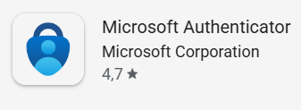


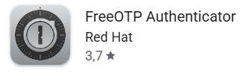


Download the mobile application
To log in to the CPP IS*, you must have an authentication application installed on your mobile phone that supports the TOTP (Time-based One-Time Password) standard. We recommend using one of the following authentication applications: Microsoft Authenticator, Google Authenticator, FreeOTP Authenticator or 2FA Authenticator (1). If you do not have one, you can download an authentication application to your mobile phone from the Google Play Store or the App Store (2).
2
1

Slide 5
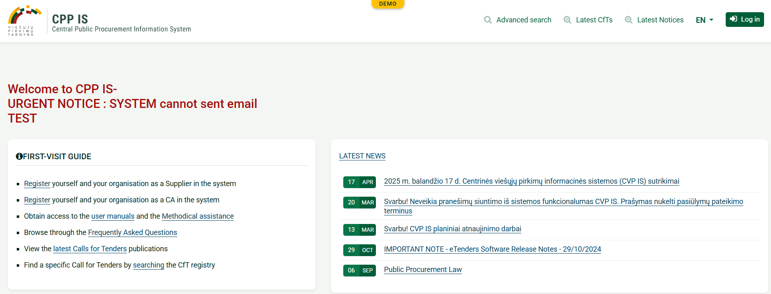
Log in to CPP IS
Access the Central Public Procurement Information System (CPP IS) https://demo.viesiejipirkimai.lt/epps/home.do, select “EN” (1) and then click “Login”(2)
1
2
* Currently the two-factor authentication feature has been implemented in the demonstration version of the CPP IS. It will also be implemented in the production version of the CPP IS in the second half of September.
IMPORTANT! To register and log in to the demonstration version of the CPP IS, you must use separate login credentials. If you have not yet registered, you will need to complete the registration form and wait for it to be approved. The login credentials used for the production version of the CPP IS are not valid for the demonstration version

Slide 6
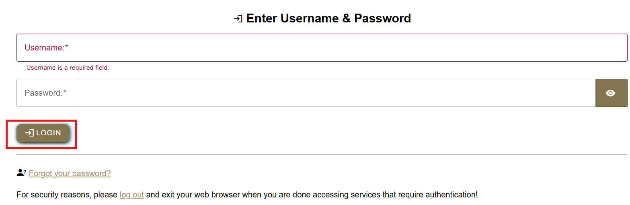
Log in to CPP IS
Enter your user name (1), password (2) and click “Login”:
1
2

Slide 7
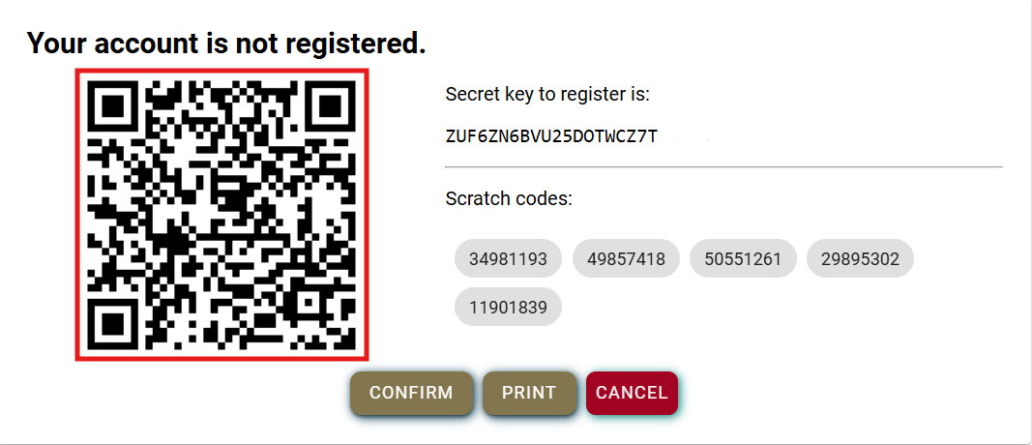
Scanning QR code with mobile phone
After logging in to CVP IS, a unique QR code will be displayed on your screen.
Open the authentication application installed on your mobile phone and scan the QR code (1). This only needs to be done the first time you log in.
Once the QR code has been scanned, you will see that the account has been added to the authentication application.
Click"Confirm" (2) on your computer screen.
IMPORTANT! Save or print the registration information displayed on the screen, including the Secret key and Scratch codes, as this information will not be displayed again later. See Slide 10 for more details.
1
SAMPLE
2

Slide 8
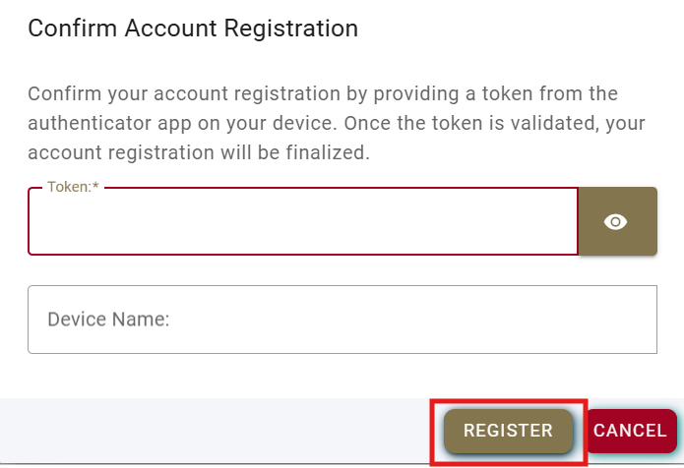
Entering the code generated by the authenticator app
In the “Token” field enter the code generated by the authenticator app on your mobile phone (1) and click “Register”. The “Device Name” field will be populated automatically, do not need to enter any information manually (2).*
1
2
IMPORTANT! The code is valid for one use only and is refreshed periodically.
*You may enter a device name. This is useful if you have more than one account, as the device name will help you identify which account is being accessed later

Slide 9
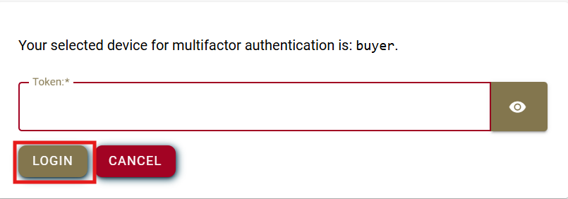
Entering the code generated by the authenticator app
In the “Token” field enter the code generated by the authenticator app again and click “Login”
IMPORTANT! Each time you sign in to CPP IS, you will be required to enter a one-time password code

Slide 10
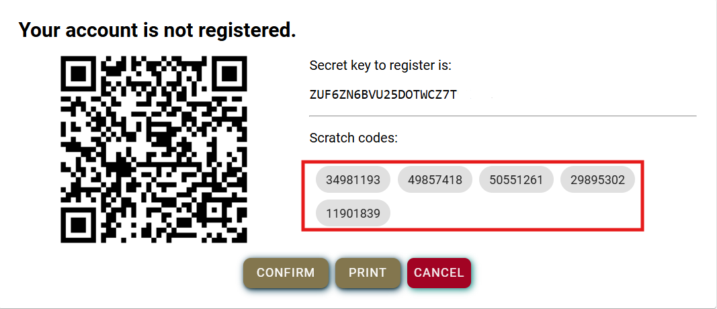
Secret key and Scratch codes
The Secret key is an alternative way to link the authentication application to your user account. If you are unable to scan the QR code (for example, if your camera is not working or if you are registering on the same phone that has the authentication application installed), or if you wish to change your authentication application, you can manually enter the Secret key into the application.
Scratch codes serve as a backup login method when you cannot access your authentication application (for example, if you lose your phone, replace your device, or the application stops working).
Each of the five one-time scratch codes can be used only once. Once a code has been used, it becomes invalid and cannot be used again
SAMPLE

Slide 11
Technical support
Email: pagalba@vpt.lt

