Slide 1

Two-factor authentication to log in to the Central Public Procurement Information System (CPP IS)
Valid from 2026-08-20

Slide 2
CONTENTS
Why is two-factor authentication required when logging in to the Central Public Procurement Information System (CPP IS) ? (Slide 3)
Download the mobile application (Slide 4)
Log in to CPP IS (Slides 5-6)
Scanning QR code with mobile phone (Slides 7-8)
Entering the code generated by the authenticator app (Slides 9-10)
Scratch codes (Slide 11)

Slide 3
Why is two-factor authentication required when logging in to the Central Public Procurement Information System (CPP IS) ?
Two-factor authentication is required when logging in to CPP IS to enhance the security of the user account and the data stored in the system:
1. Protection against unauthorized access. Even if someone were to obtain your username and password, these alone would not be sufficient to access your account.
2. Protection of sensitive data. CPP IS contains public procurement information, documents and user data, therefore, it is essential to ensure their security.
3. Identity verification. The second authentication step (the code generated by the authentication application) confirms that the person attempting to log in is the actual account owner.
4. Reduction of cyber threats. Two-factor authentication helps protect against common attacks, such as password theft, data breaches and phishing attempts.
5. Compliance with legal and security requirements. Government information systems are subject to stringent information security requirements. Therefore, additional authentication is one of the measures used to ensure system protection.
IMPORTANT! CPP IS user login credentials (username and password) are confidential information and must be stored securely and used only for personal access. Sharing login credentials with third parties is strictly prohibited

Slide 4
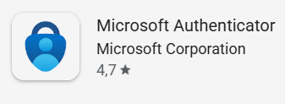





Download the mobile application
To log in to the CPP IS*, you must have an authentication application installed on your mobile phone that supports the TOTP (Time-based One-Time Password) standard. We recommend using one of the following authentication applications: Microsoft Authenticator, Google Authenticator, FreeOTP Authenticator or 2FA Authenticator (1). If you do not have one, you can download an authentication application to your mobile phone from the Google Play Store or the App Store (2).
2
1
* Currently the two-factor authentication feature has been implemented in the demonstration version of the CPP IS. It will also be implemented in the production version of the CPP IS in mid-September

Slide 5
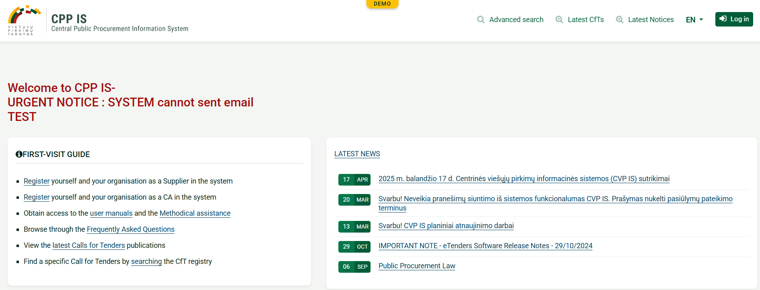
Log in to CPP IS
Access the Central Public Procurement Information System (CPP IS) https://demo.viesiejipirkimai.lt/epps/home.do, select “EN” (1) and then click “Login”(2)
1
2
* Currently the two-factor authentication feature has been implemented in the demonstration version of the CPP IS. It will also be implemented in the production version of the CPP IS in mid-September

Slide 6
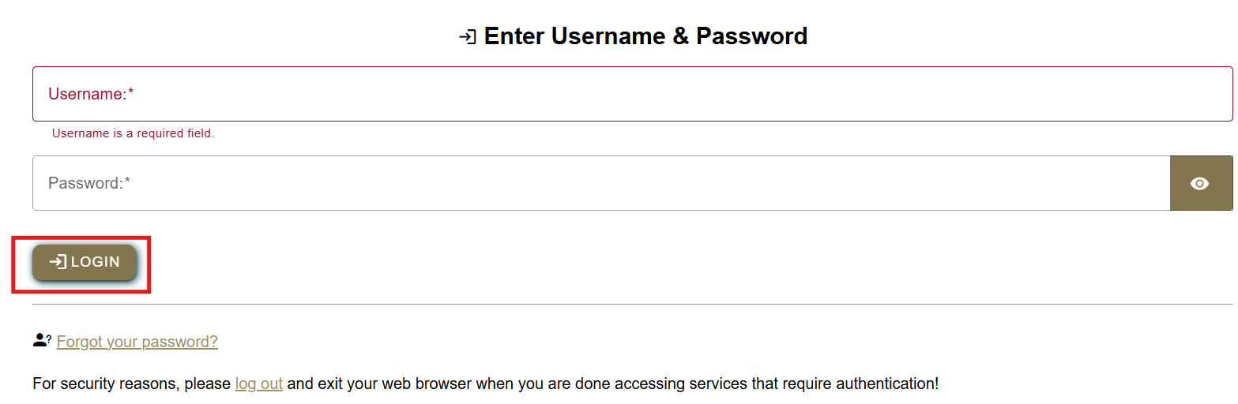
Log in to CPP IS
Enter your user name (1), password (2) and click “Login”:
1
2

Slide 7
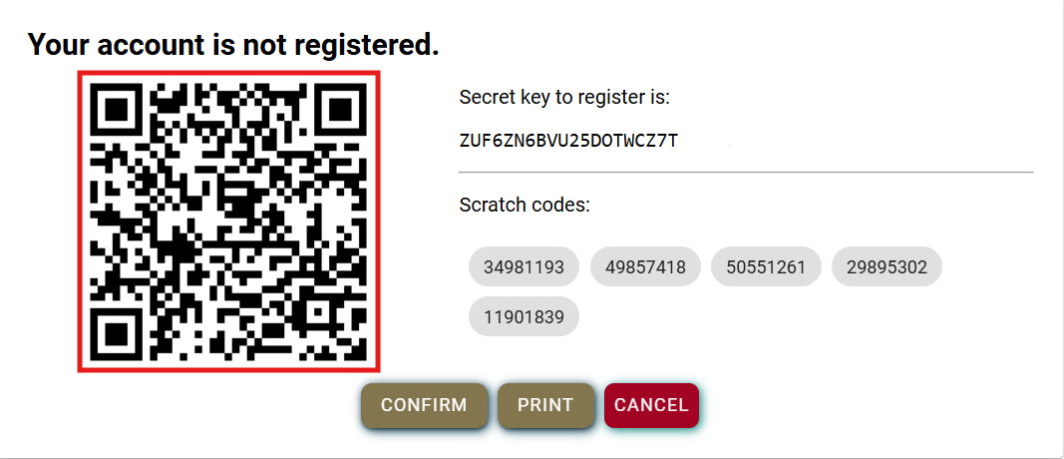
Scanning QR code with mobile phone
Open the authenticator app on your mobile phone and scan the QR code.
IMPORTANT! Please securely save or print the registration information displayed on the screen, including the secret key and scratch codes. This information will not be displayed again later
IMPORTANT! QR code scanning is required only during the first login.
The secret key is an alternative method of linking the authenticator application to the user's account. If you are unable to scan the QR code (for example, if the camera is not working or if you are registering on the same phone where the authenticator application is installed), you can manually enter the secret key into the authenticator application

Slide 8
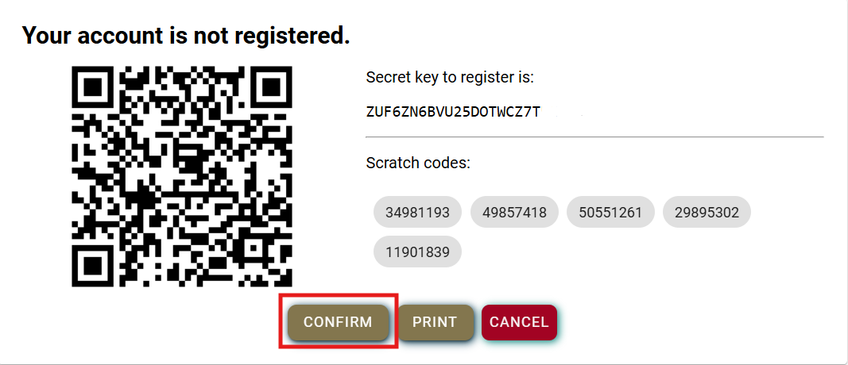
Scanning QR code with mobile phone
After scanning the QR code with the mobile phone authentication app, you will see that the account has been added. On your computer screen click “Confirm”:

Slide 9
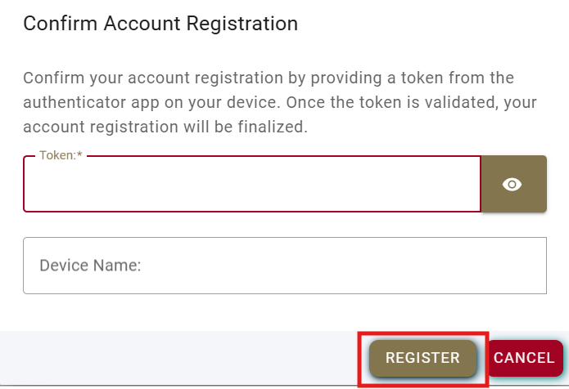
Entering the code generated by the authenticator app
In the “Token” field enter the code generated by the authenticator app on your mobile phone (1) and click “Register”. The “Device Name” field will be populated automatically, do not need to enter any information manually (2).*
1
2
IMPORTANT! The code is valid for one use only and is refreshed periodically.
*You may enter a device name. This is useful if you have more than one account, as the device name will help you identify which account is being accessed later

Slide 10
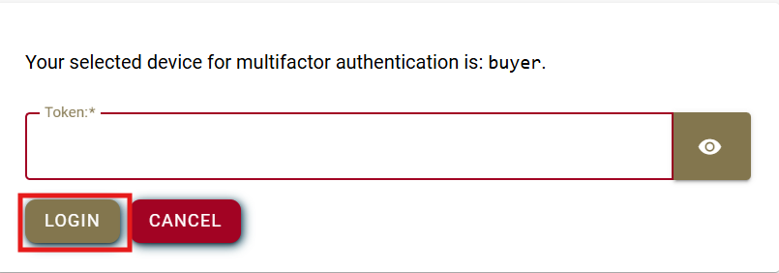
Entering the code generated by the authenticator app
In the “Token” field enter the code generated by the authenticator app again and click “Login”
IMPORTANT! Each time you sign in to CPP IS, you will be required to enter a one-time password code

Slide 11
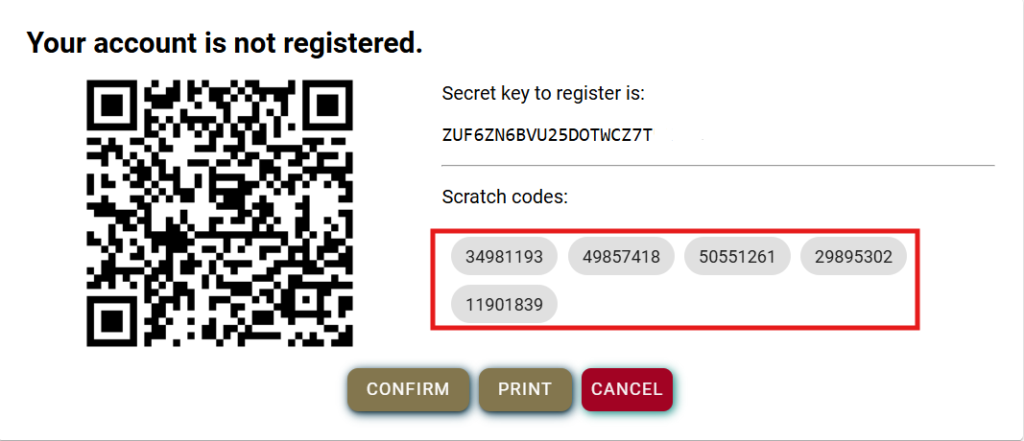
Scratch codes
IMPORTANT! Scratch codes serve as a backup sign in method if you are unable to access your authenticator app (for example, if you lose your phone, switch devices or the app stops working).
Each of the five scratch codes can be used only once. After a code has been used, it is no longer valid.

Slide 12
Technical support
Email: pagalba@vpt.lt

