Slide 1

Submission of proposals and requests for clarification regarding preliminary market consultation documents via the Central Public Procurement Information System (CVP IS)
Valid from 2026-06-19

Slide 2
CONTENTS
Submission of requests for clarification (Slides 3-11)
Viewing messages sent by the contracting authority (Slides 12-14)
Submission of proposals (Slides 14-16)
Review of responses provided by the contracting authority to received requests for clarification and submitted proposals (Slides 17-18)

Slide 3
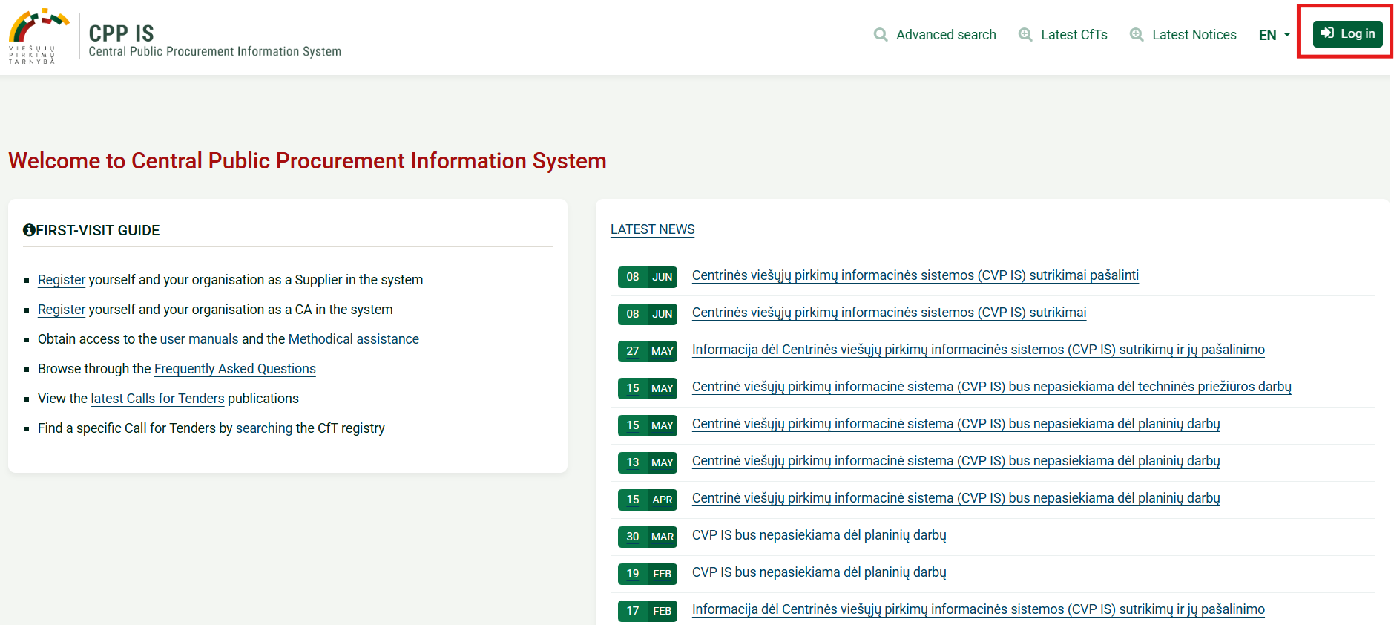
Login to CVP IS
Log in to the Central Public Procurement Information System (CVP IS) via:
https://viesiejipirkimai.lt/epps/home.do

Slide 4
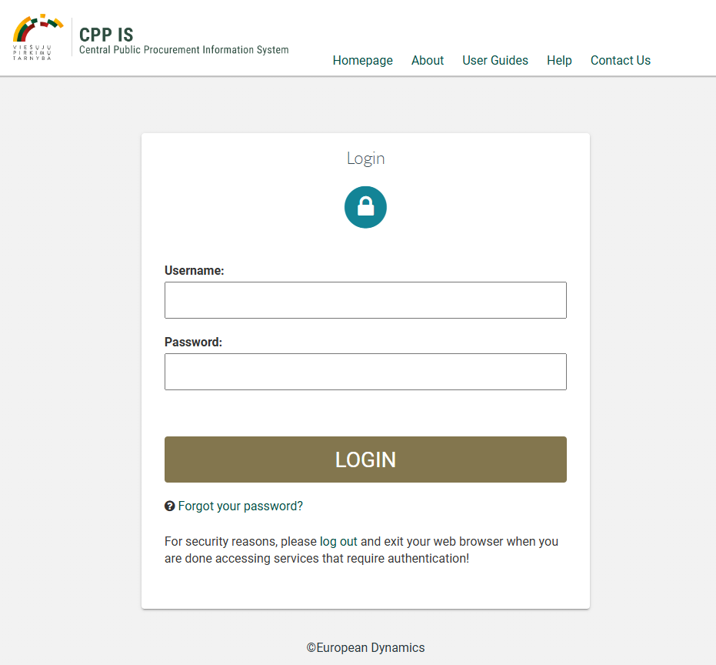
Login to CVP IS
Enter your username
(must be all lowercase letters)
Enter password

Slide 5
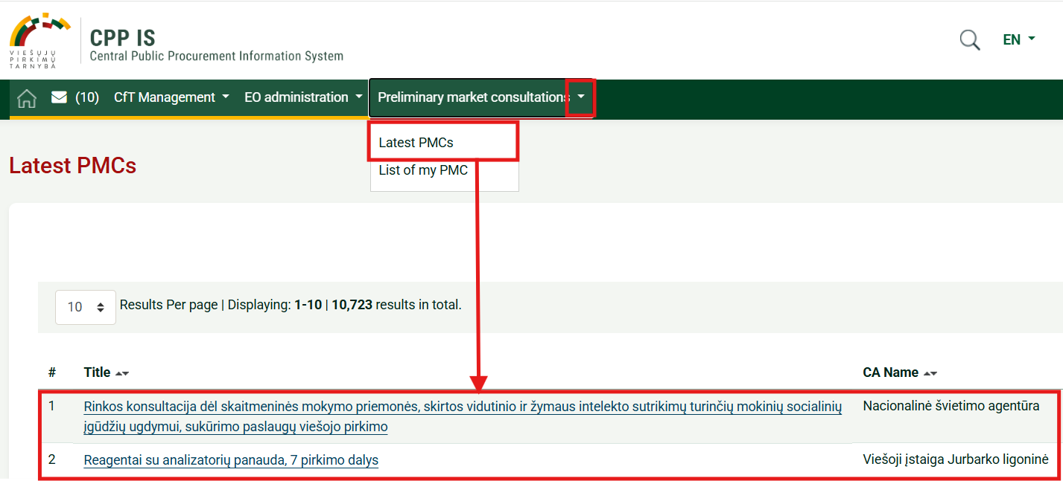
Submission of requests for clarification
After logging into CVP IS, all newly published invitations for preliminary market consultation or draft technical specifications can be found in two ways:
Method 1
1
2

Slide 6
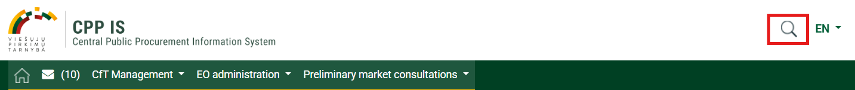
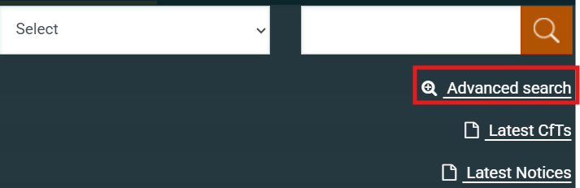
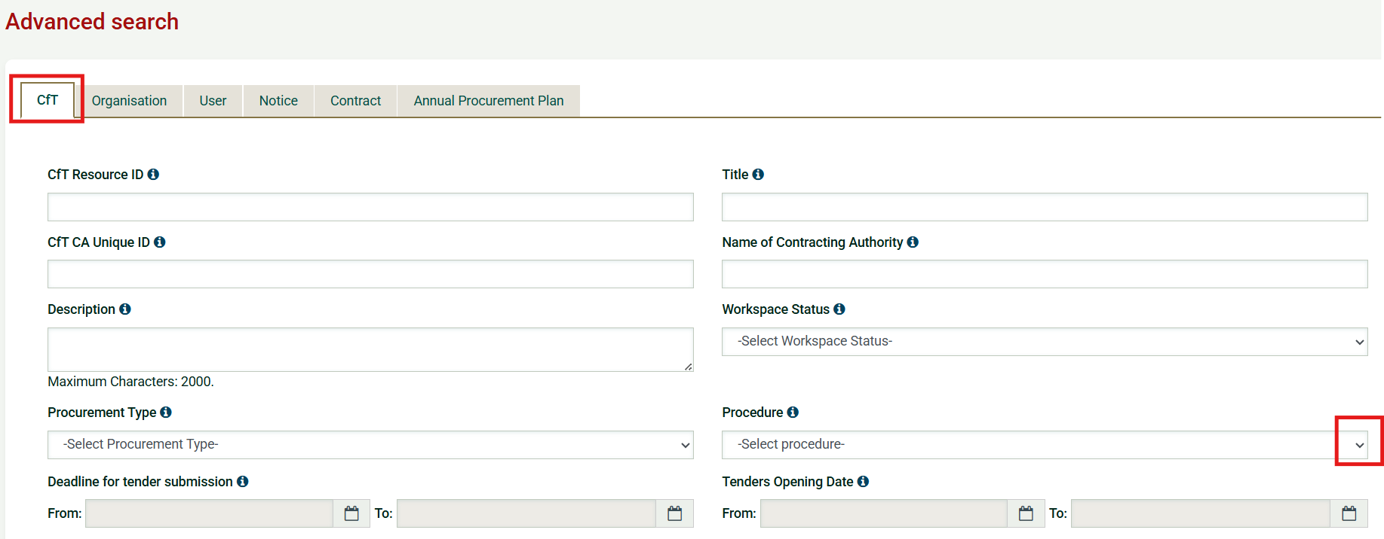
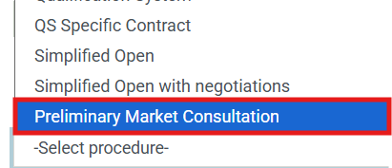
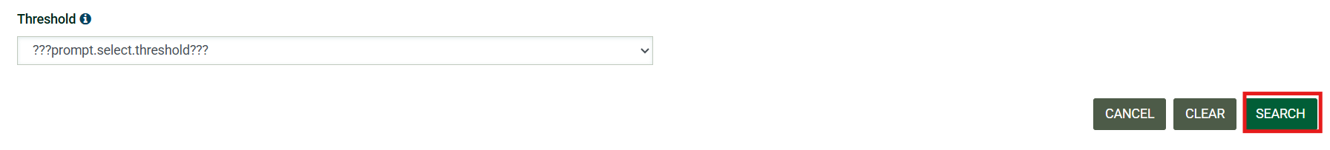
Submission of requests for clarification
Method 2
1
2
3
4
5

Slide 7
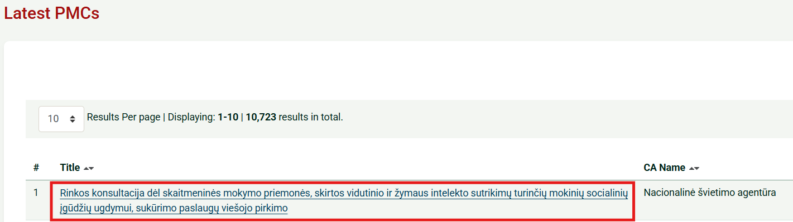
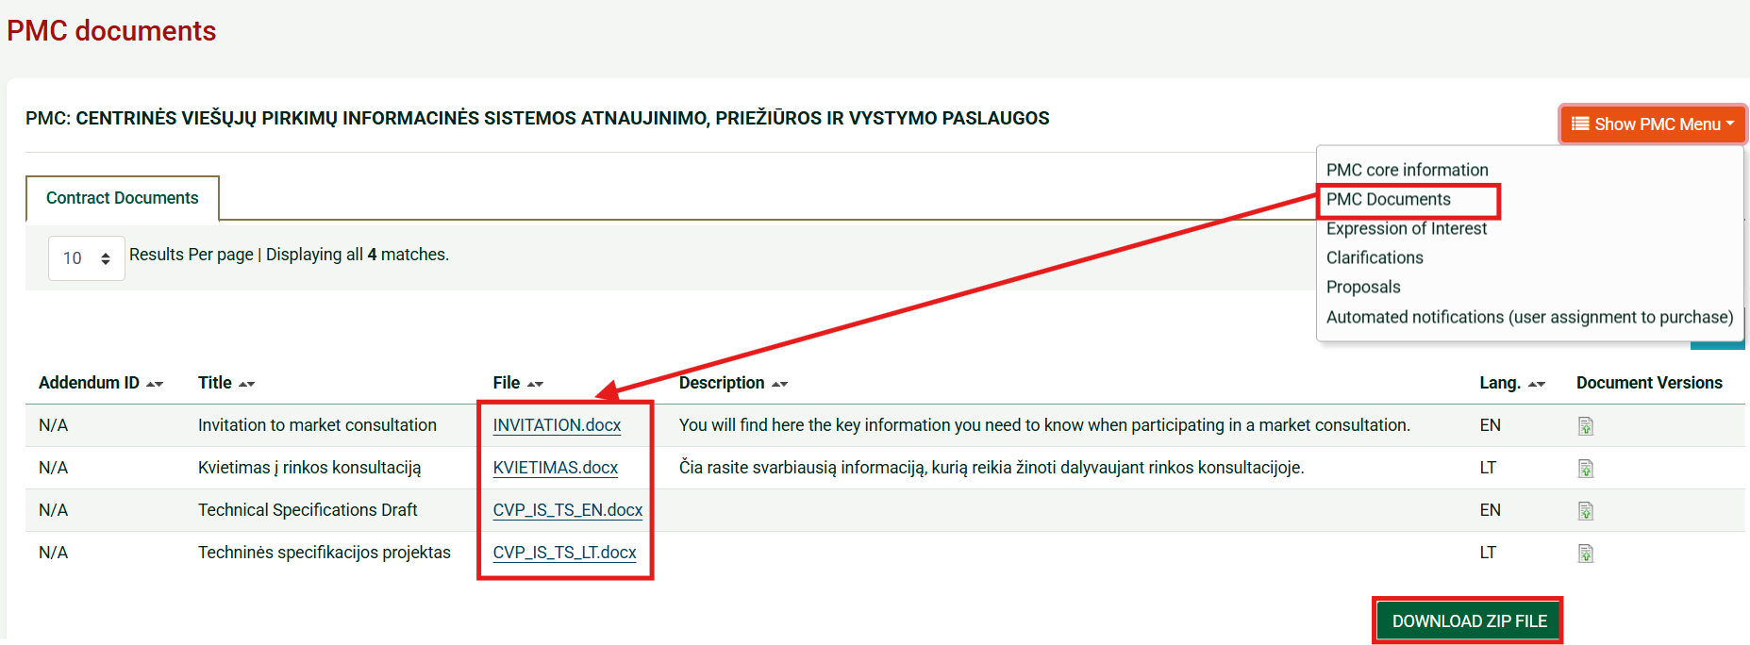
Submission of requests for clarification
Specific preliminary market consultation documents or draft technical specifications can be viewed under “PMC Documents” (2):
1
2
All documents can be downloaded as a ZIP file

Slide 8
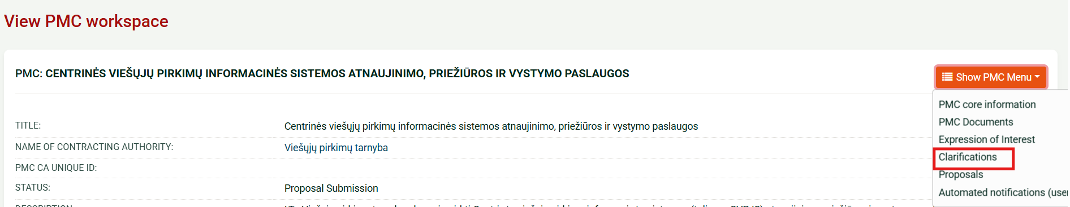
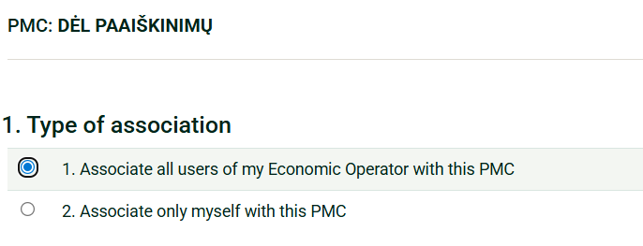

Submission of requests for clarification
The clarification request function is used when a supplier lacks certain information or it is unclear, preventing submission of proposals.
If the supplier wants to submit specific suggestions for document amendments, it is recommended to use the proposal submission function (see slides 14–16).
Steps to submit a clarification request:
1
2
3
Indicate whether to associate all supplier users or only yourself with the selected preliminary market consultation
4

Slide 9
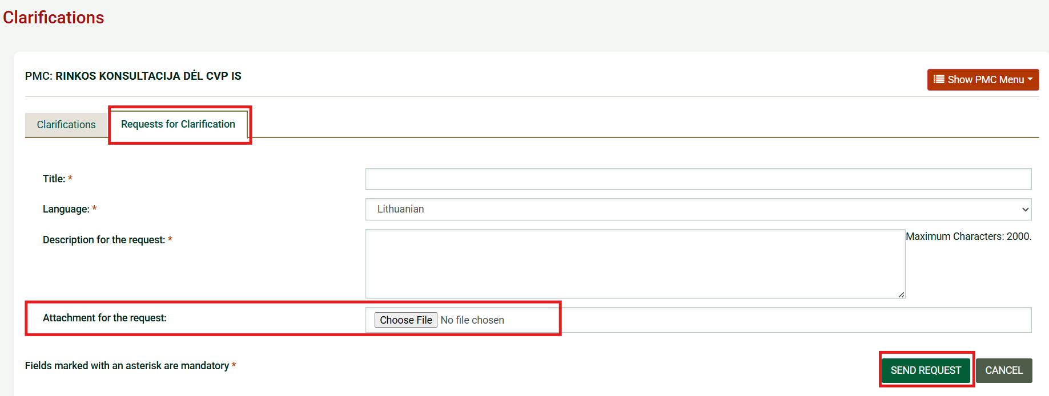
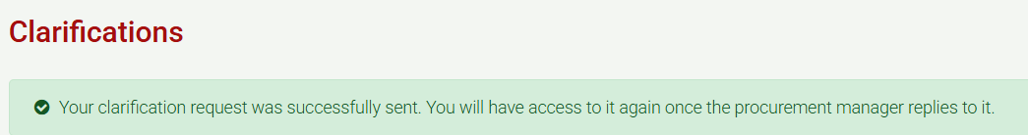
Submission of requests for clarification
Fill in all required fields in the opened window, attach a file if needed, and click “Send request” (1)
Note: If the contracting authority did not allow attaching documents when creating the consultation, the “Attachment” field will not appear
1
2
A confirmation message is displayed once the request is successfully sent
Required fields
IMPORTANT! After the submission deadline, the supplier can no longer submit clarification requests

Slide 10
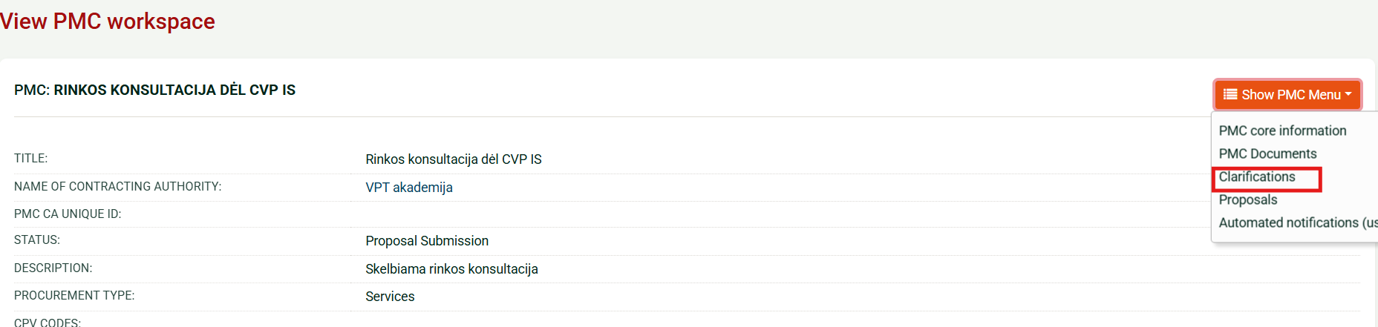
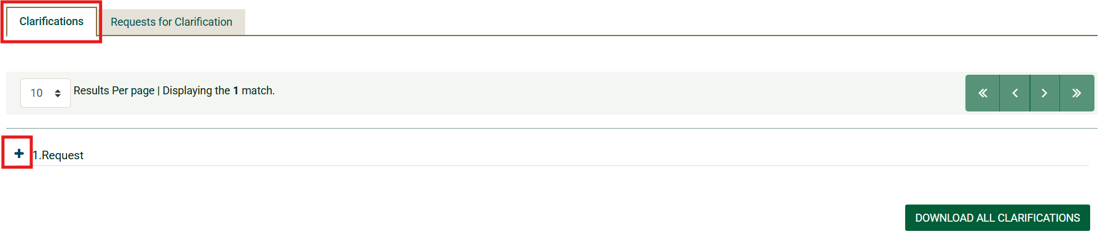
Submission of requests for clarification
When the contracting authority responds, the supplier is notified by email.
To view the response, follow the steps:
1
2
3
IMPORTANT! The submitted request will appear in the “Clarifications” section only after the authority has provided a response

Slide 11
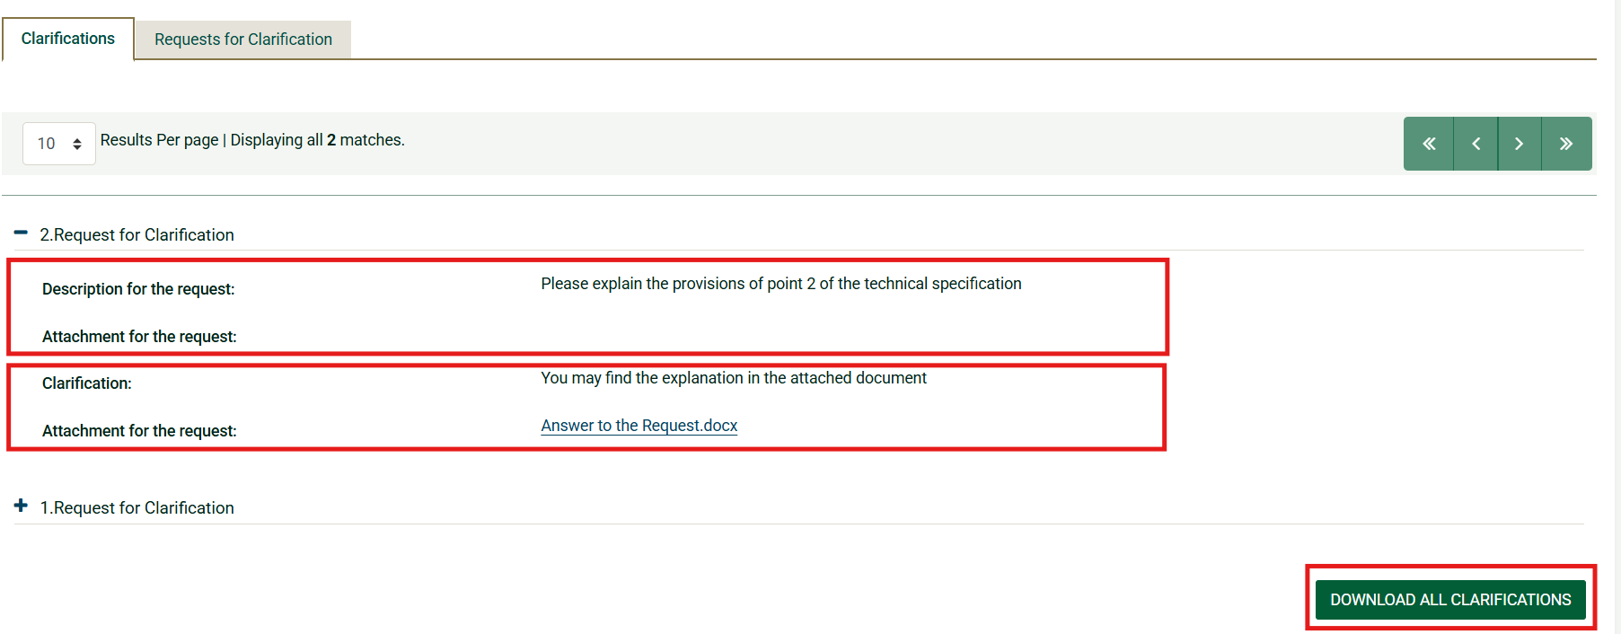
Submission of requests for clarification
In the opened window, the supplier can see their submitted request and the contracting authority’s response.
Request for clarification submitted by the supplier
Response from the contracting authority
By clicking “Download all clarifications”, a list of all suppliers’ requests submitted during the preliminary market consultation and the contracting authority’s responses, along with attachments, will be downloaded

Slide 12
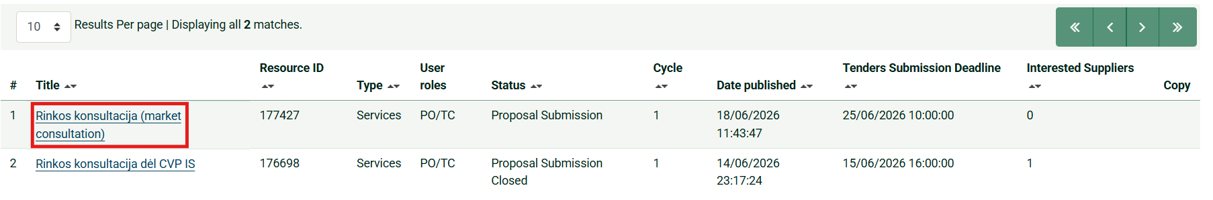
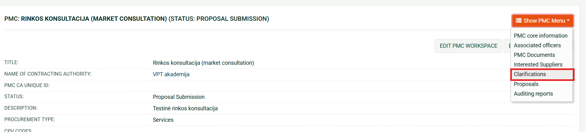
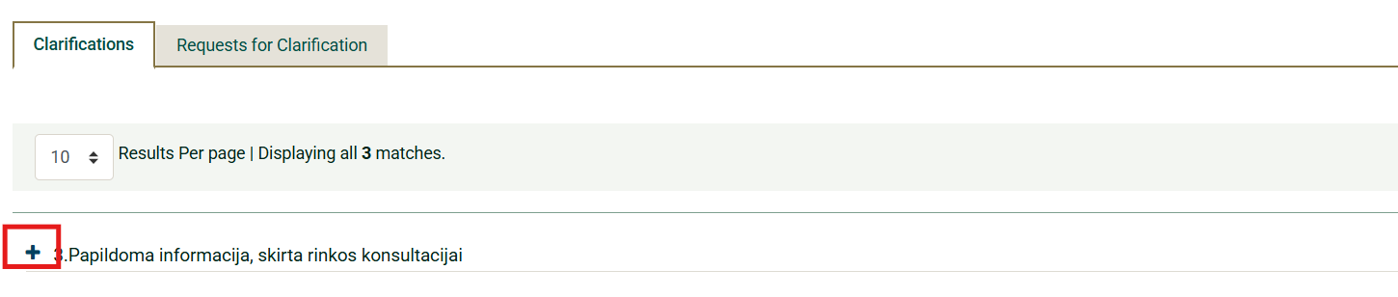
Viewing messages from the contracting authority
The contracting authority may send messages on its own initiative (without receiving a request).
The supplier is notified by email and can view the message by following the steps:
1
2
3

Slide 13
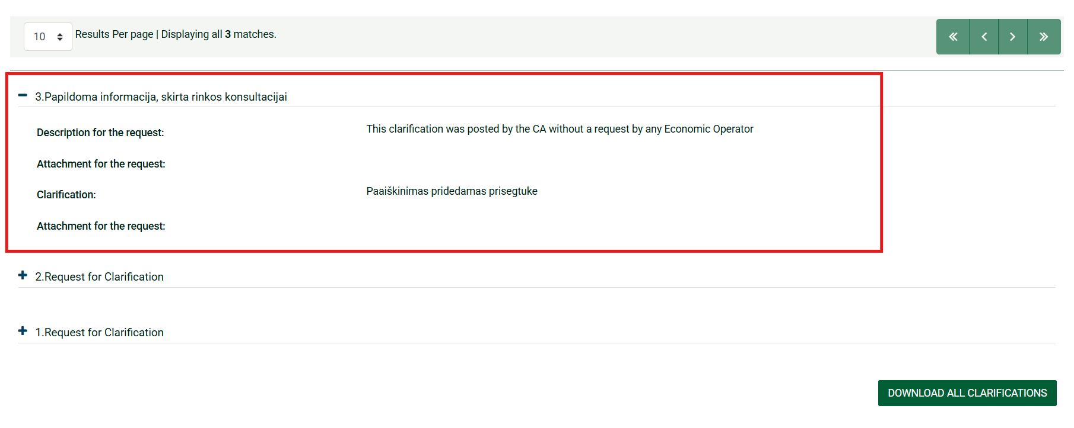
Viewing messages from the contracting authority
In the opened window, the supplier sees the message sent by the contracting authority

Slide 14
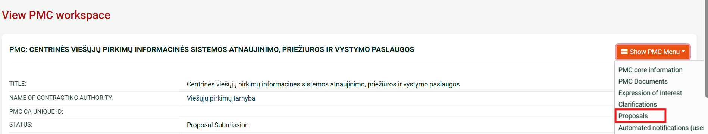
Submission of proposals
To submit a proposal regarding preliminary market consultation, follow the steps:
1
2
If you haven‘t submitted a clarification request, please
indicate whether to associate all supplier users or only yourself with the selected preliminary market consultation. If you have already submitted a clarification request, you do not need to repeat this step
3
4

Slide 15
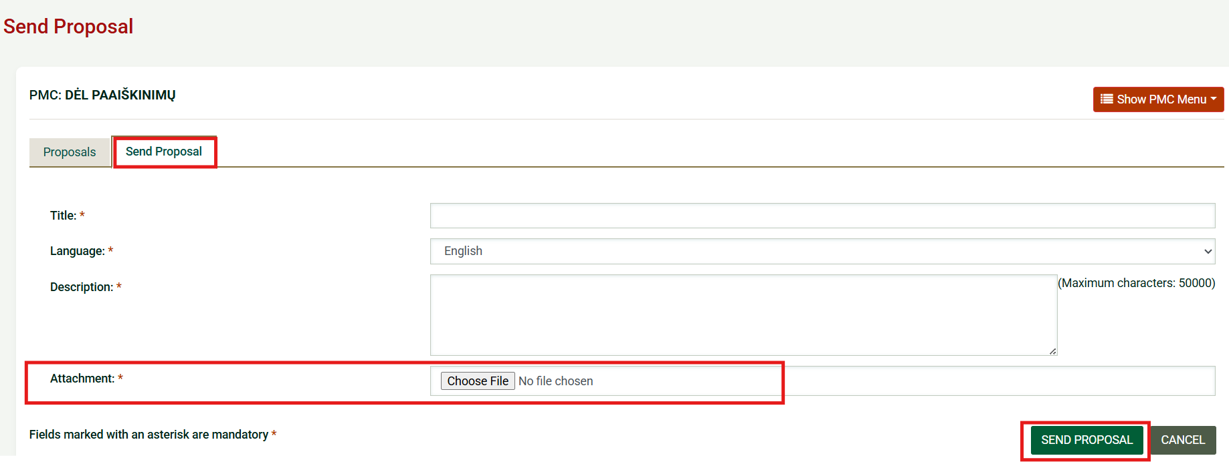
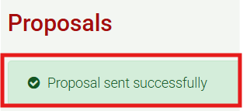
Submission of proposals
Select “Send proposal” (1), fill in required fields, and click “Send proposal” (2)
1
2
A confirmation message is displayed once the proposal is successfully sent
Required fields

Slide 16
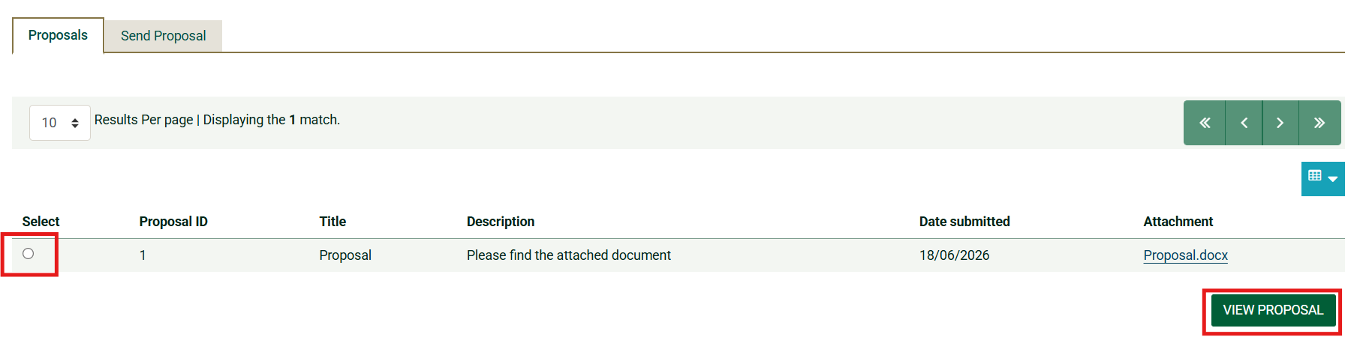
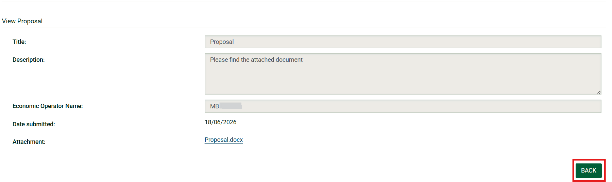
Submission of proposals
To view a submitted proposal:
In the “Proposals” section select the proposal (1)
Click “View proposal” (2)
1
2
To return, click “Back” (3)
3

Slide 17
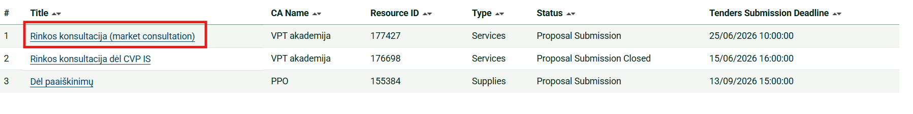
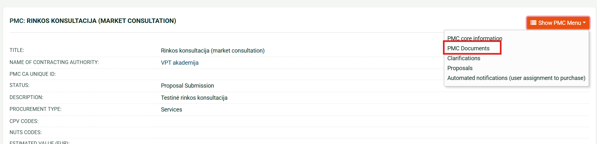
Review of responses provided by the contracting authority to received requests for clarification and submitted proposals
The contracting authority must provide decisions on requests and proposals before the start of procurement procedures.
When new documents are uploaded, the supplier is notified by email.
Decisions can be viewed under “PMC Documents” (2)
1
2

Slide 18
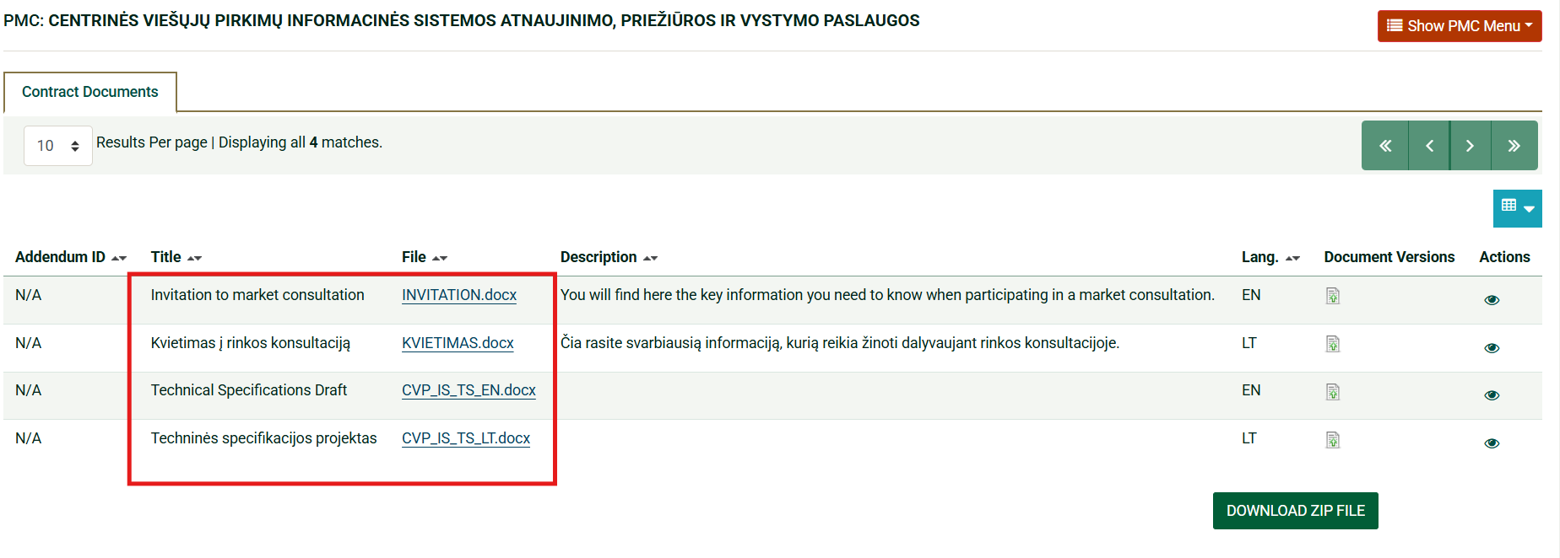
Review of responses provided by the contracting authority to received requests for clarification and submitted proposals
In the opened window, the supplier sees all preliminary market consultation documents and the contracting authority’s decisions regarding submitted requests and proposals

Slide 19
Technical support
Email: pagalba@vpt.lt

