Slide 1

Economic operator company roles and it‘s management
Valid from 2026-05-20

Slide 2
Roles available
EO Admin
EO User
There is no limit to the number of users in different EO Admin and EO User roles. It means that Economic Operator might have X of EO Admin users and Y of EO Users.
Attention! One person might be either EO Admin or EO User

Slide 3
Roles – functionality available
Edit the organisation details
Add/delete other users
Complete ESPD
Expression of interest/clarifications request
Prepare and submit tenders
Accept/reject contract award
EO Admin
Express an interest in a Call for Tender
Submit a request for clarification and view responses
Prepare and submit tender returns
Accept/reject contract awards
EO User

Slide 4
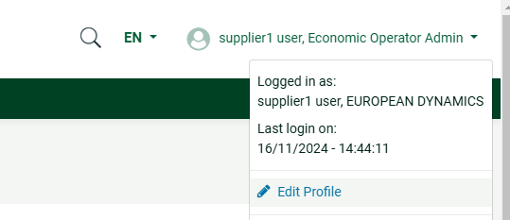
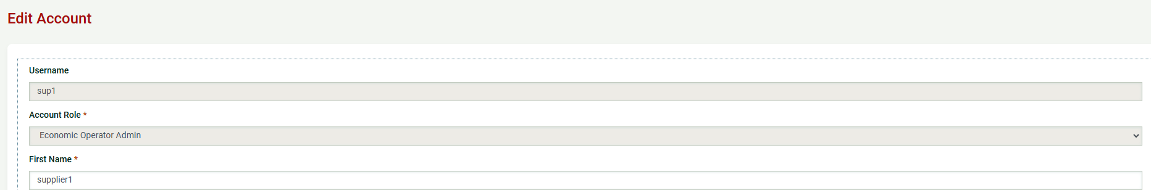
Attention! The very first user registered in the system gain EO Admin role.
To check account role user can pushing on his name (1) and then choosing Edit Profile (2). At Account role field he can see his account role in the system (3)
1
2
3

Slide 5
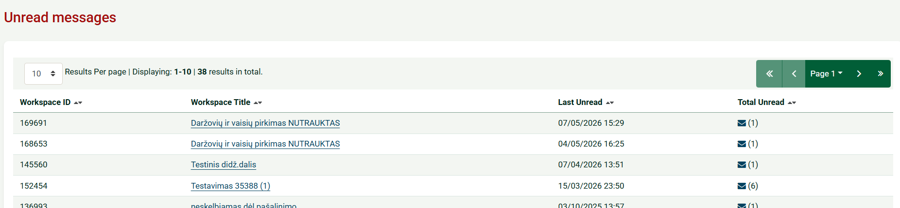
Supplier account page
Please pay attention to where unread messages can be found (1).
Clicking on the envelope icon displays the list of procurements with unread messages (2).
If you have not received any messages or have already read them, the envelope icon will no longer be displayed in the menu
1
2

Slide 6
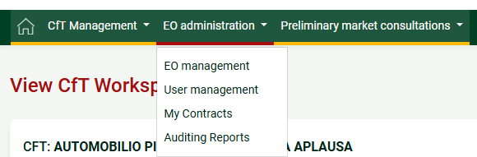
Organisation management
The Users assigned with the “Economic Operator Organisation Administrator” role can perform the following activities for the management of their organisation:
  Edit organisation details
  View the users registered within the organisation of the Economic Operator
  Add new users in the organisation of the Economic Operator
  Edit user’s details
By clicking on the ‘’EO Administration’’ a dropdown menu will be displayed and then by selecting the ‘’EO Management’’ option, this management functionality is provided

Slide 7
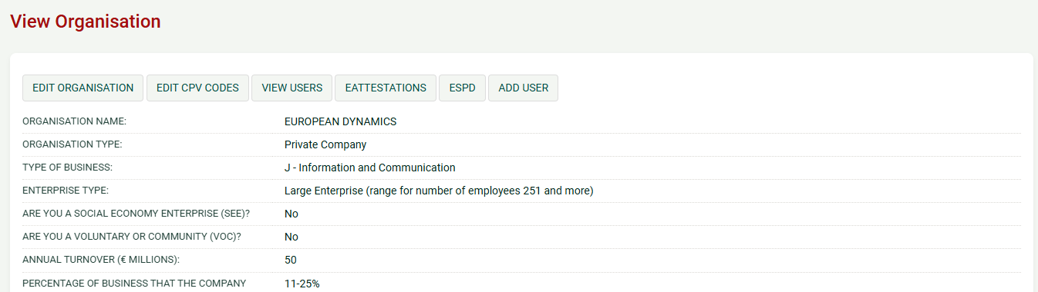
Organisation management
The system displays the organisation details in “Read only” format.
Attention! Please note that the Economic Operator User role does not have access to the above functionality. For example, the Economic Operator User cannot edit the organisation’s information and they cannot add new user

Slide 8
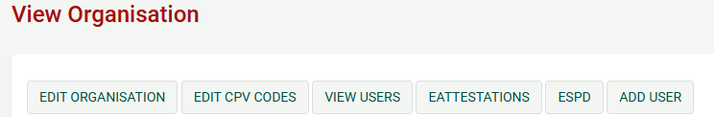
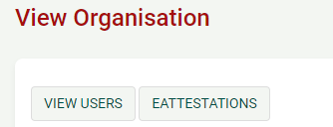
Organisation management
EO Admin has such functionalities in the EO management:
EO User has less functionalities than EO Admin user:

Slide 9
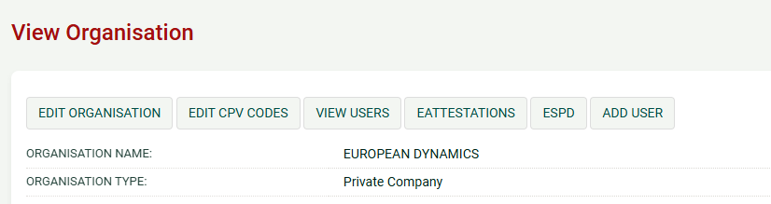
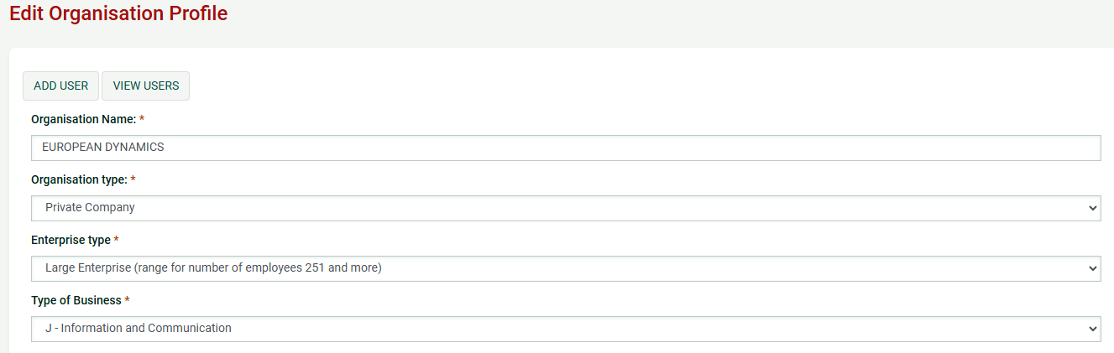
EO Admin functionalities
Edit organisation details
Selecting the option “EDIT ORGANISATION” allows the user to edit the organisation’s details

Slide 10
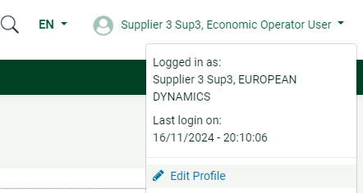
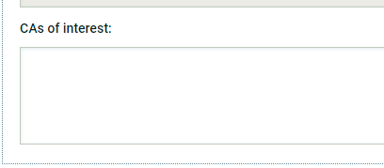
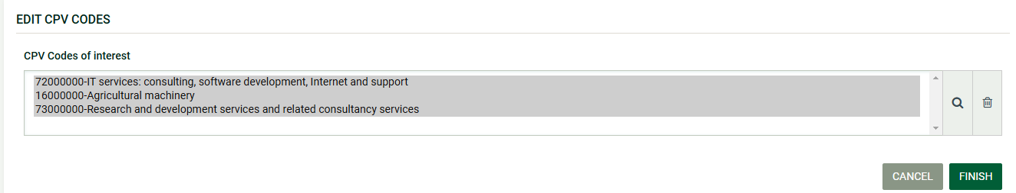
EO Admin functionalities
Editing CPV codes of interest
In order to set-up or edit the CPV codes associated with the Economic Operator the EO Admin clicks on the “EDIT CPV CODES” option in EO Organisation management page. This page can be accessed viewing the EO Administration dropdown by selecting EO Management.
When the organisation administrator sets-up their CPV codes of interest, only EO admins will receive one overnight email with the list all the Competitions published under a CPV code that they have an interest of. There is an additional alert functionality which is available both for users and admins and it is the CAs of interest, which users can find in their profile information (1)
1

Slide 11
Please note that you can only select 100 CPV codes in the above screen. This selection then allows to receive automated alerts on the exact CPV codes matching your above selection.
The purpose of selecting CPV codes is to allow companies to receive automated email notifications each time a new publication of a CfT is made on CPV matching the CPV codes selected by the company in their profile. This thus allows companies to automatically be notified on new tender opportunities. The alerts on CPV operate as described in the following:
Registered Suppliers will receive business alerts for a published tender notice where:
Both contracting authority and supplier have the same top code (i.e. CA uses 15000000 and EO uses 15000000).
Both contracting authority and supplier have the same sub-code (i.e. CA uses 15131130 and the EO uses 15131130).
If contracting authority has top code and supplier has sub-code from the same top tree (i.e. CA uses 15000000 and the EO uses 15131134)
If supplier has top code and contracting authority has sub-code from the same top tree (i.e. CA uses 15131130 and the EO uses 15000000)
Registered Suppliers will not receive business alerts for a published tender notice where:
Contracting authority and supplier have different sub-codes even where it is in the same tree (i.e. CA uses 15131130 and the EO uses 15131134)
Note: A sub-code is any code below the top one

Slide 12
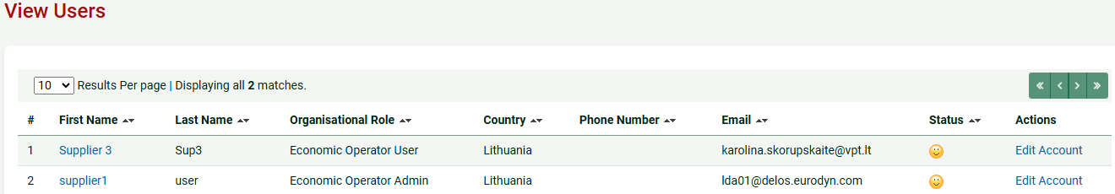

EO Admin functionalities
Viewing users registered in the organization
Selecting the option “VIEW USERS” displays all the users registered within the selected Economic Operator organisation
It should be noted that if the user's status is inactive (i.e., this icon is visible ), it means that they have not logged into the system and have not entered the unique activation code (registration transaction number) that they receive by email (immediately after creating their user account)

Slide 13
EO Admin functionalities
In the above screen, the first name, last name, the role and the country of each user are displayed. Furthermore, the current status of each user account is also displayed:
Active
Inactive (In order to activate such accounts the user must provide this number during their first login. Thereafter, the status of the account will be active)
Deactivated
De-activate a user: The EO Admin account owner can edit the user accounts and deactivate the accounts of the old users that do not need to use the system anymore. The EO admin can deactivate the accounts by adding a past date or today's date in the "Valid to" field and hit "Save" then the account status will update to "Deactivated"

Slide 14
EO Admin functionalities
At this moment eAttestation functionality (Certificates) is unavailable, so please do not select it

Slide 15
EO Admin functionalities
ESPD. At this moment ESPD functionality is unavailable, so please do not select it. For ESPD creation EO should use this link https://ebvpd.eviesiejipirkimai.lt/espd-web/filter?lang=lt

Slide 16
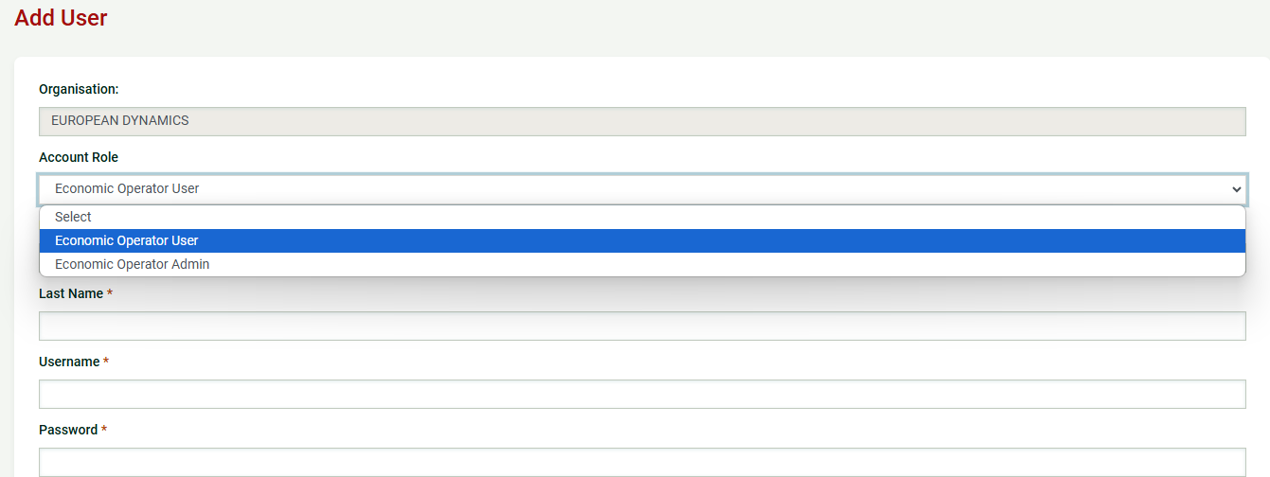
EO Admin functionalities
Add new user to the organisation
The mandatory information (marked with “*”) should be provided. Once done, the user should click on the “SAVE” button

Slide 17
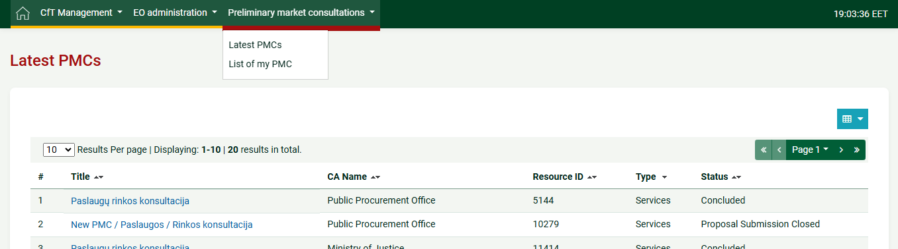
EO Admin functionalities
Preliminary market consultations (PMC)
The purpose of the preliminary market consultation is to allow the CAs to obtain a clear picture of certain products and services are available on the market.
If the EO Admin clicks on the “List of my PMC” option, they can see the list with the PMCs that they are associated with.
If the EO Admin clicks on the “Latest PMCs” option, they will have the latest PMCs that the Contracting Authorities created. They can find the PMC that they are interested. If they go to “View PMC Workspace” (they can find it by clicking on the title of the PMC), they can find more information for the PMC

Slide 18
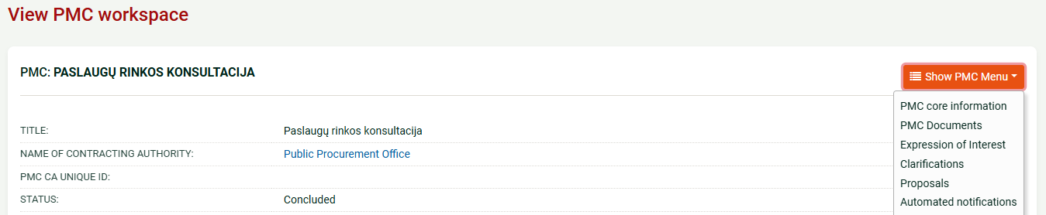
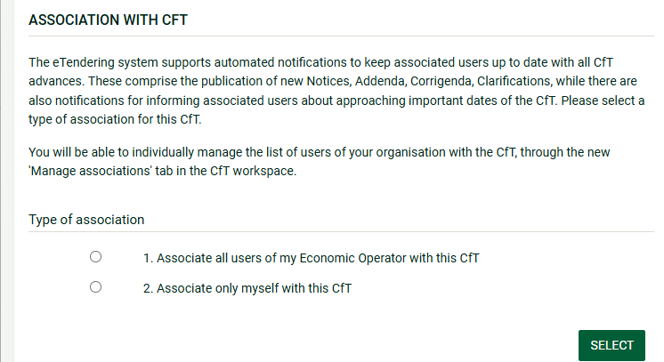
EO Admin functionalities
By clicking on the “Show PMC Menu” (below figure), users can find the PMC documents, they can express an interest, they can request for clarifications, they can do a proposal and they can manage the automated notifications
When the user clicks on the “Expression of interest” button for the first time, the system will display the below figure. The user has to select one of these 2 options. If the user selects “Associate all users of my Economic Operator with this CfT”, then all Economic operators will have this PMC in the “List of my PMCs”.

Slide 19
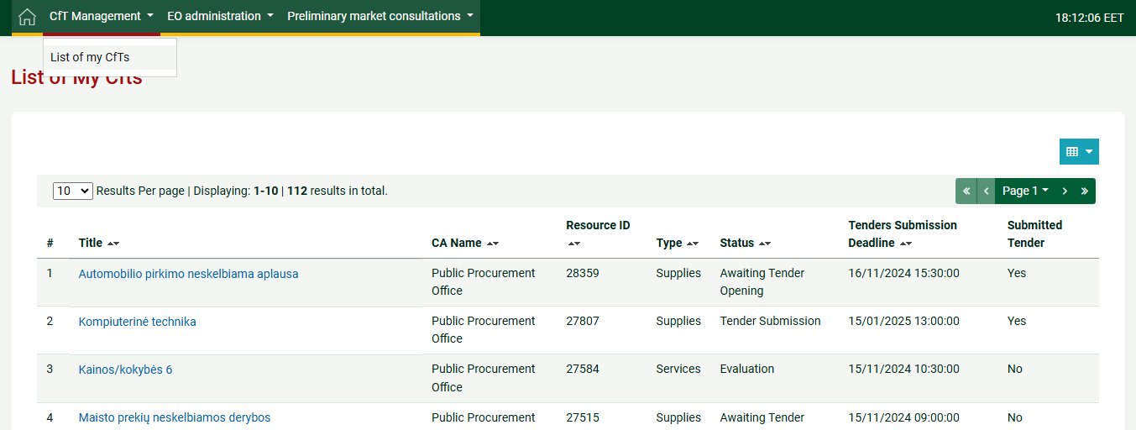
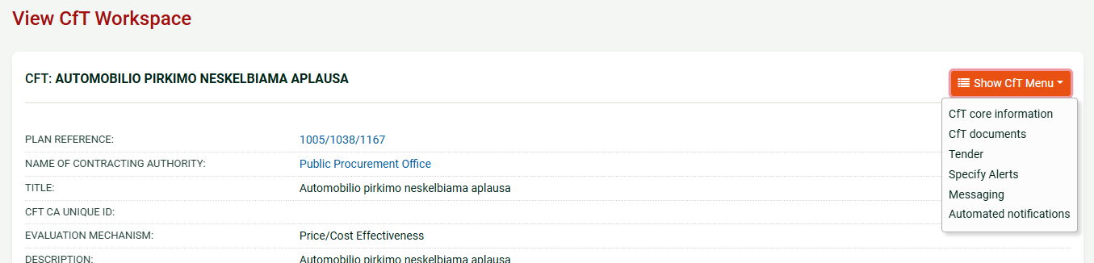
EO Admin functionalities
Call for Tender (CfT) Management
The “List of my CfTs” contains all the CfTs that the user is associated with (1). For example the CfTs that they expressed an interest or the CfTs where they did a tender submission. Also, if another user of the company associates all user accounts (and yours) when they express an interest or when they do their tender submission, you will have these CfTs under the “list of my CfTs”
1
Possibilities related with concrete tender user can find on concrete tender (2) > Show CtF Menu (3)
2
3

Slide 20
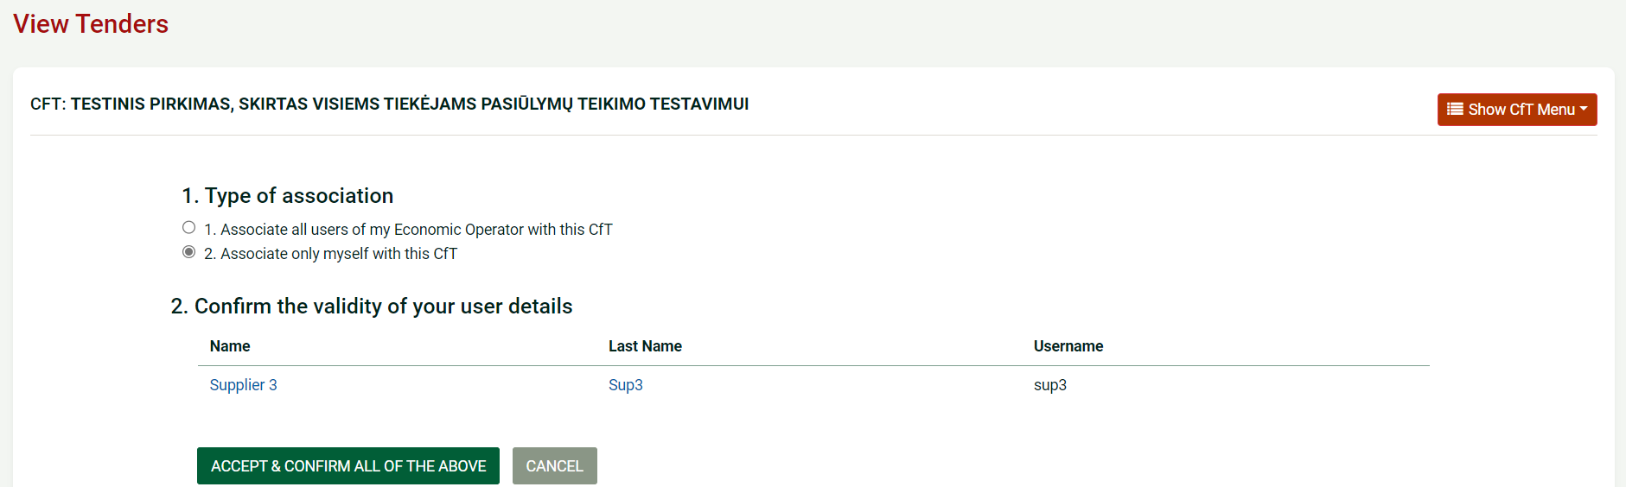
Once the user expresses an interest in the Call for Tender, it will be displayed under the “List of my CfTs” as depicted in the below screenshot
1
The same agreement the user has to accept when he begin creating a tender. He have to confirm the validity of their user details. The user clicks on the “ACCEPT & CONFIRM ALL OF THE ABOVE” button to proceed

Slide 21
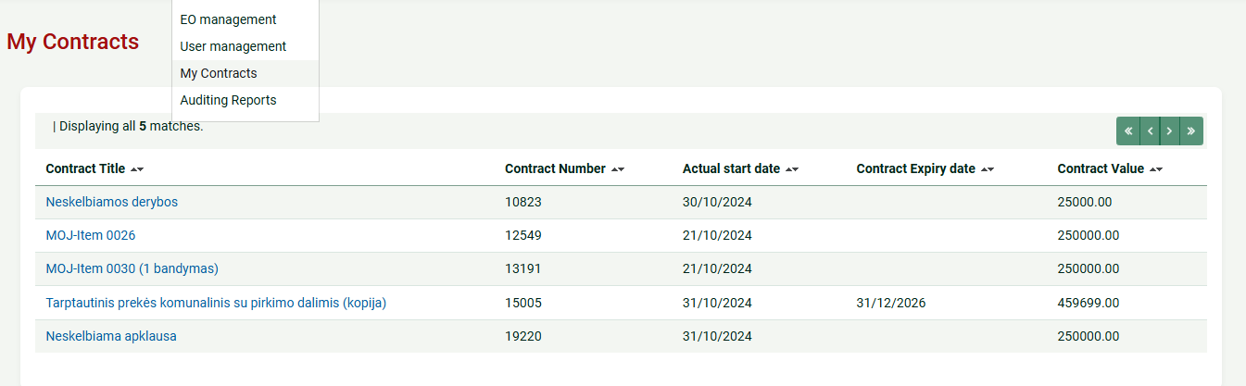
EO Admin functionalities
View Contracts
After the Economic Operator has accepted the contract, a new contract workspace is created in the system and the user can access it by clicking on the main menu, on tab “EO administration” tab and selecting the “My Contracts” label in the dropdown options
The user can access the list of all contracts under their organisation (for which they are granted access) and view the details of every contract

Slide 22
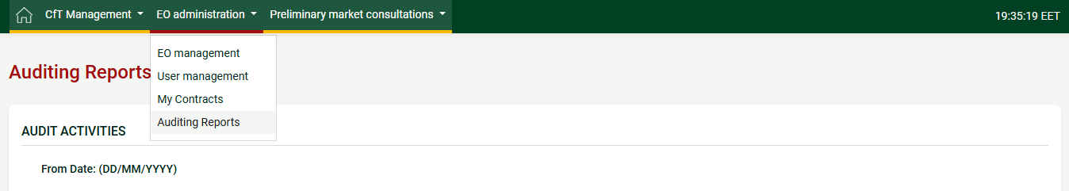
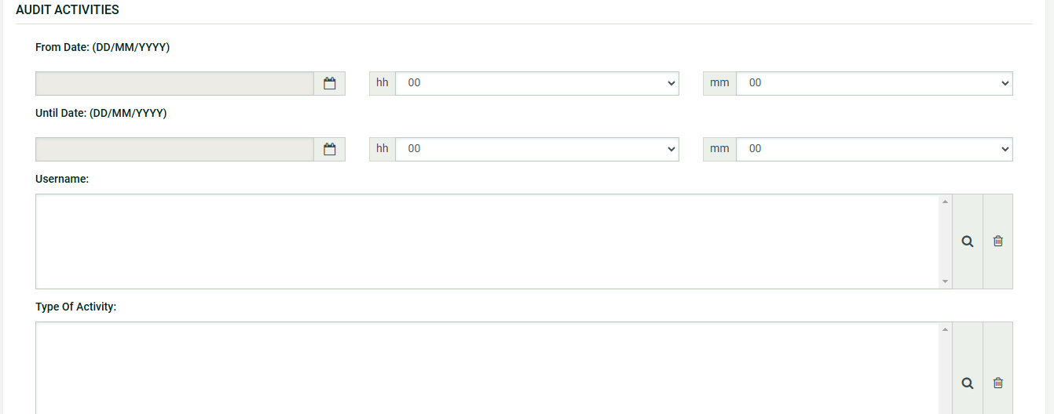
EO Admin functionalities
Auditing reports
Functionality that helps to view actions of organisation users

Slide 23
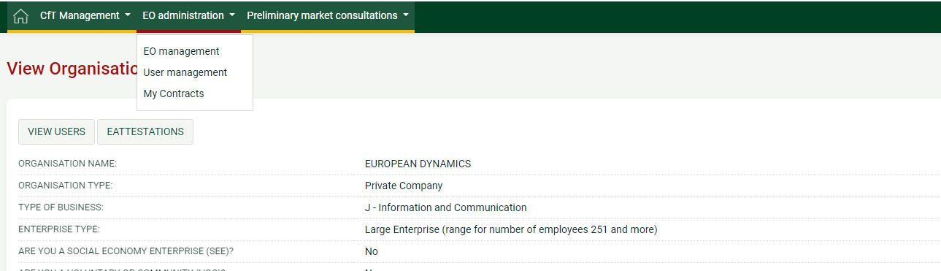
EO User functionalities
View organisation details, but not edit them
View organisation details in EO Administration > EO Management

Slide 24
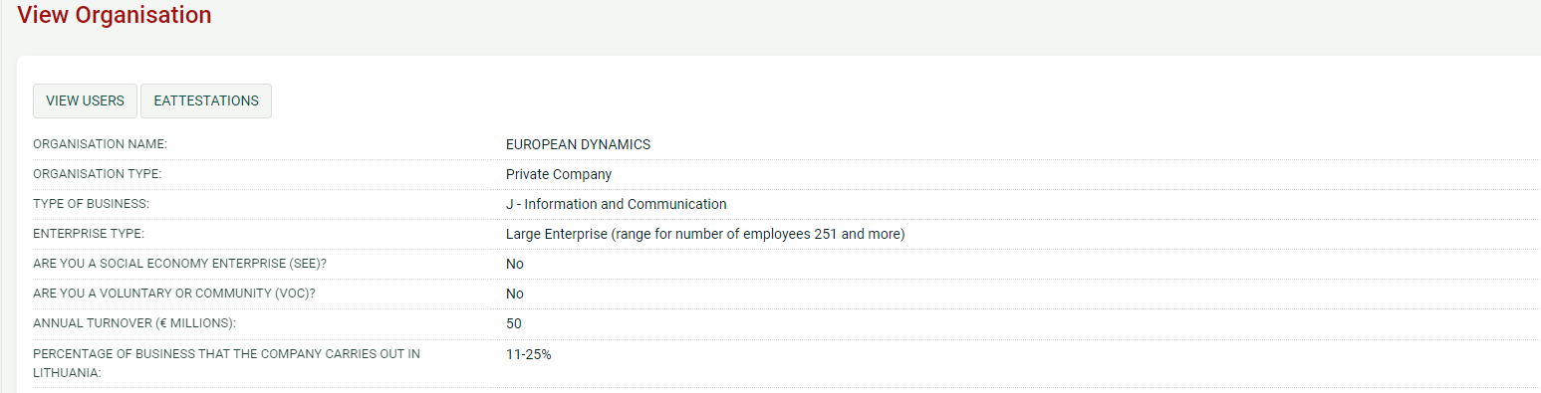
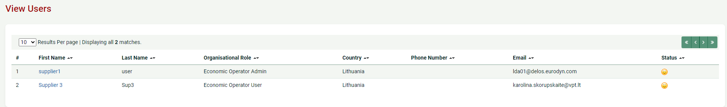
EO User functionalities
View all economic operator users
To view economic operator users EO administration > EO management > View users

Slide 25
EO Admin functionalities
Preliminary market consultations (PMC)
The purpose of the preliminary market consultation is to allow the CAs to obtain a clear picture of certain products and services are available on the market.
If the EO User clicks on the “List of my PMC” option, they can see the list with the PMCs that they are associated with.
If the EO User clicks on the “Latest PMCs” option, they will have the latest PMCs that the Contracting Authorities created. They can find the PMC that they are interested. If they go to “View PMC Workspace” (they can find it by clicking on the title of the PMC), they can find more information for the PMC

Slide 26
EO Admin functionalities
By clicking on the “Show PMC Menu” (below figure), users can find the PMC documents, they can express an interest, they can request for clarifications, they can do a proposal and they can manage the automated notifications
When the user clicks on the “Expression of interest” button for the first time, the system will display the below figure. The user has to select one of these 2 options. If the user selects “Associate all users of my Economic Operator with this CfT”, then all Economic operators will have this PMC in the “List of my PMCs”

Slide 27
EO User functionalities
Call for Tender (CfT) Management
The “List of my CfTs” contains all the CfTs that the user is associated with (1). For example the CfTs that they expressed an interest or the CfTs where they did a tender submission. Also, if another user of the company associates all user accounts (and yours) when they express an interest or when they do their tender submission, you will have these CfTs under the “list of my CfTs”
1
Possibilities related with concrete tender user can find on concrete tender (2) > Show CtF Menu (3)
2
3

Slide 28
Once the user expresses an interest in the Call for Tender, it will be displayed under the “List of my CfTs” as depicted in the below screenshot
1
The same agreement the user has to accept when he begin creating a tender. He have to confirm the validity of their user details. The user clicks on the “ACCEPT & CONFIRM ALL OF THE ABOVE” button to proceed

Slide 29
EO User functionalities
View Contracts
After the Economic Operator has accepted the contract, a new contract workspace is created in the system and the user can access it by clicking on the main menu, on tab “EO administration” tab and selecting the “My Contracts” label in the dropdown options
The user can access the list of all contracts under their organisation (for which they are granted access) and view the details of every contract

Slide 30
Technical support
Email: pagalba@vpt.lt

