Slide 1

How to develop and submit a tender (proposal) using CVP IS?
Valid from 2026-05-20

Slide 2
Contents
How to search in CVP IS? (Slides 3-7)
How to submit a bid in a test tender? (Slides 8–27)
How to submit a bid in a Design contest? (Slides 28–37)
Information about the submitted proposal and how to amend or withdraw it (Slides 38–42)

Slide 3
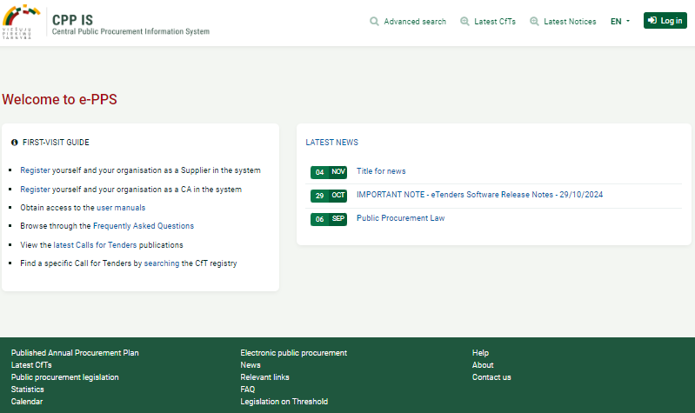
How can I find CVP IS in English language?
Access the Central Public Procurement Information System (CVP IS) at https://viesiejipirkimai.lt/epps/home.do, select “EN” (1), and then click “Log in”(2)
1
2

Slide 4
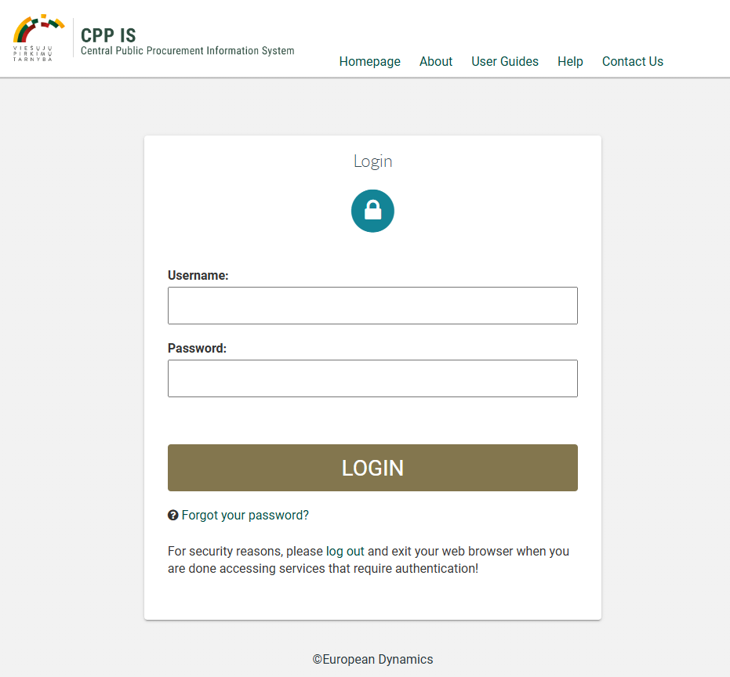
Enter your username (must be all lowercase letters)
Enter password

Slide 5
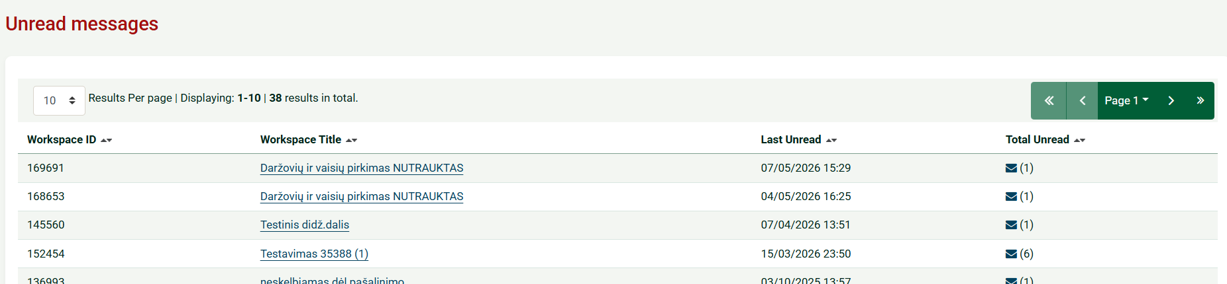
Supplier account page
Please pay attention to where unread messages can be found (1)
Clicking on the envelope icon displays the list of procurements with unread messages (2)
1
2

Slide 6
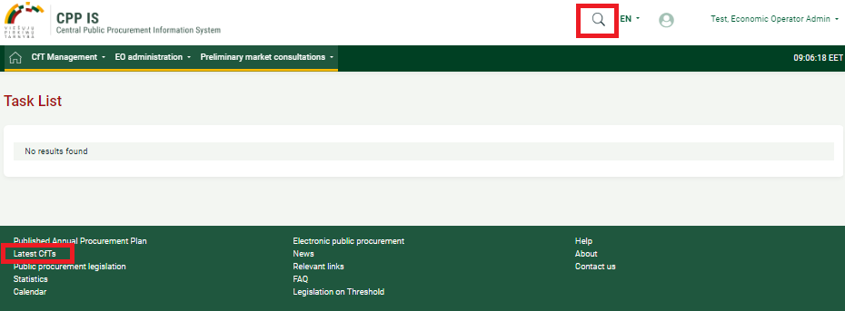
Once logged in, you can search for purchases (CfTs) in several ways 1 or 2:
1
2

Slide 7
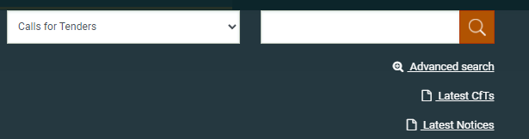
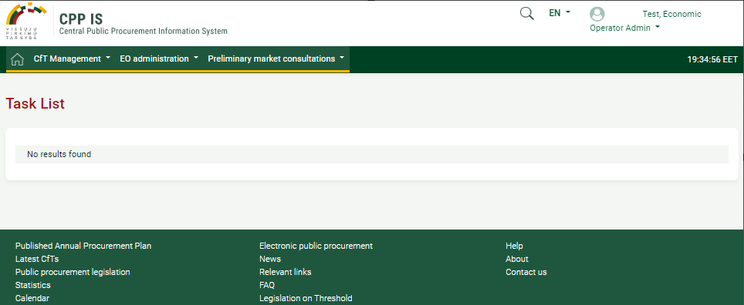
When conducting a search in this way, click on “Latest CfTs” and you will be redirected to all tenders.
You can try out a sample purchase in the DEMO environment European Dynamics - Welcome to CPP IS- </br>URGENT NOTICE : SYSTEM cannot sent email</br>TEST
Please submit bids on a trial tender with ID 28249

Slide 8
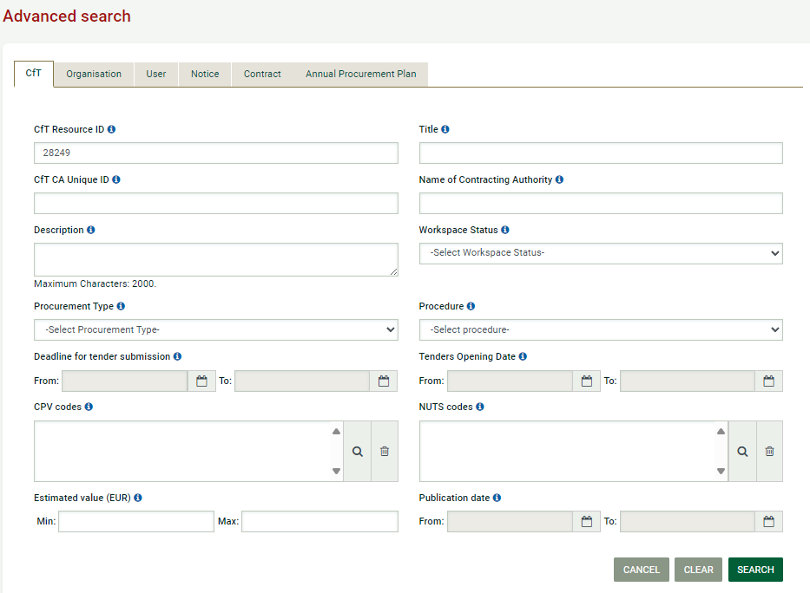
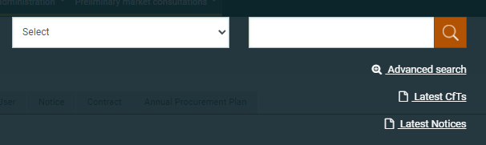
For a more detailed search, click on “Advanced search” and enter the tender ID in the “Cft Resource ID” section and click on “Search”
2
1
3

Slide 9
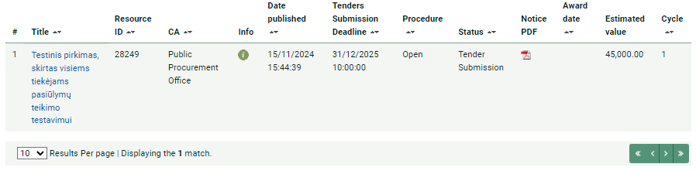
How to submit a bid in a test tender?
Click on the tender name to bid on a trial tender with ID 28249

Slide 10
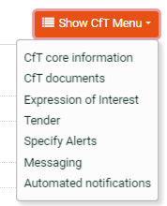
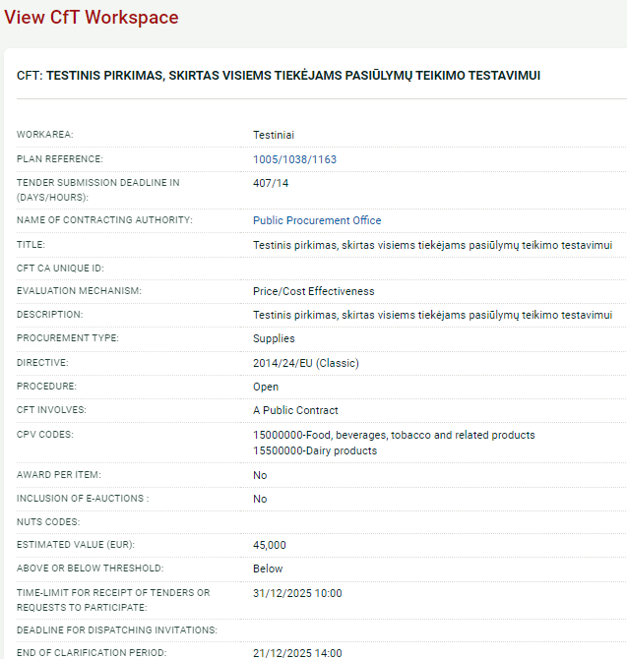
CfT core information
Shows basic information about the purchase

Slide 11
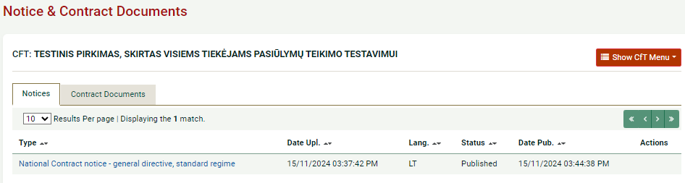
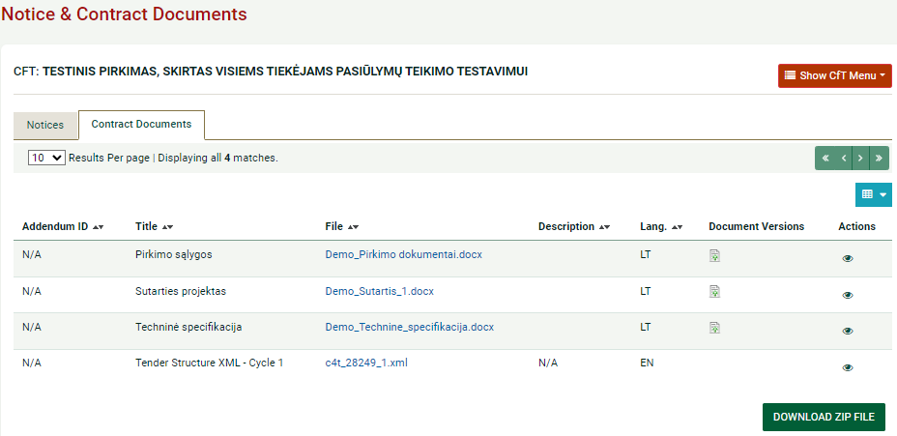
You can find out information about the purchase by extracting the menu ”Cft documents”
Cft documents:
Notices
Contracts Documents:
To view
to download zip file

Slide 12
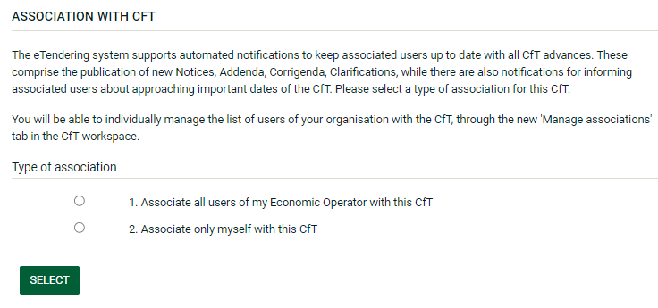
Choose type of association:

Slide 13
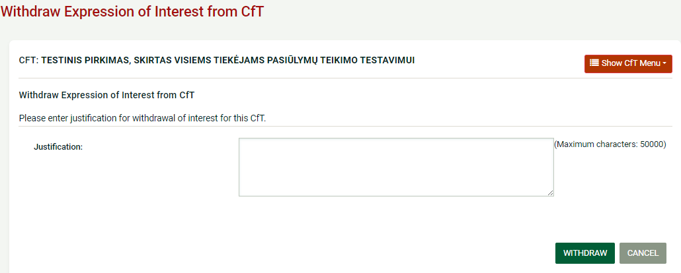
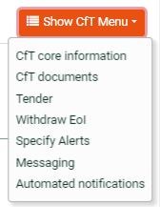
Withdraw Expression of Interest from CfT

Slide 14
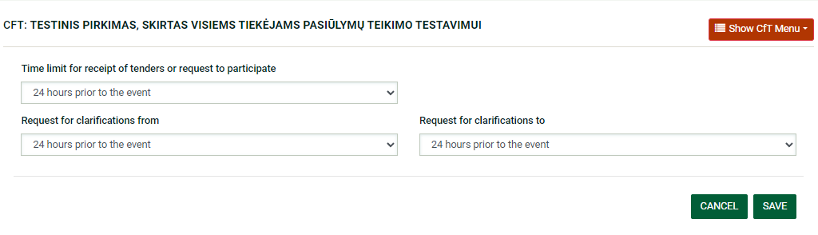
Specify Alerts.
Can set deadlines for receiving notifications

Slide 15
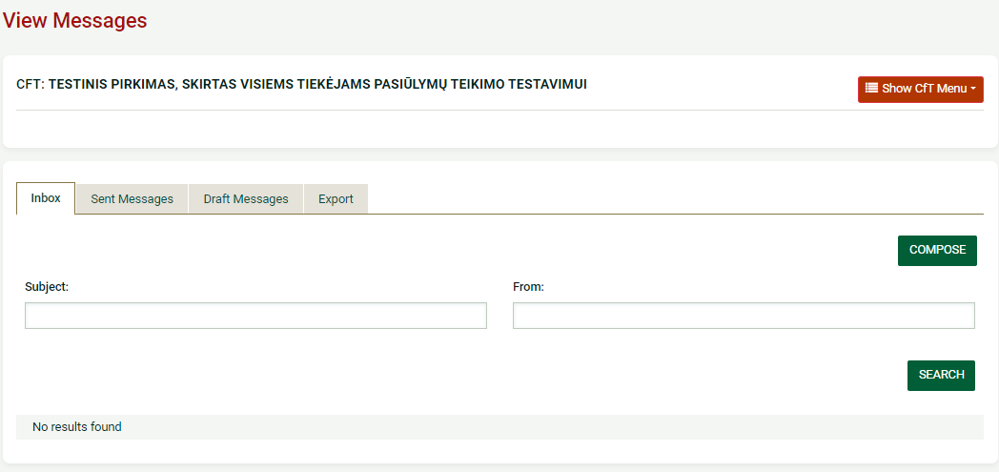
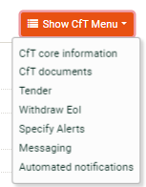
View Messages
Important! If you intend to withdraw your application from the dynamic purchasing system (DPS), please notify the contracting authority via the Messaging section

Slide 16
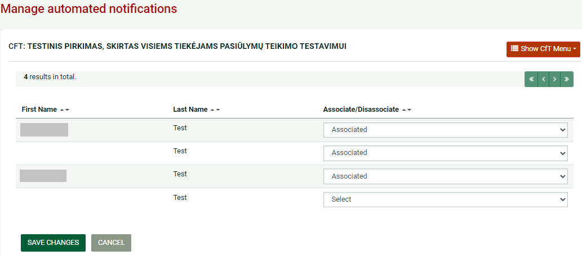

Manage automated notifications. Can edit the notification settings by clicking on the "Automated notifications" section of the tender menu

Slide 17
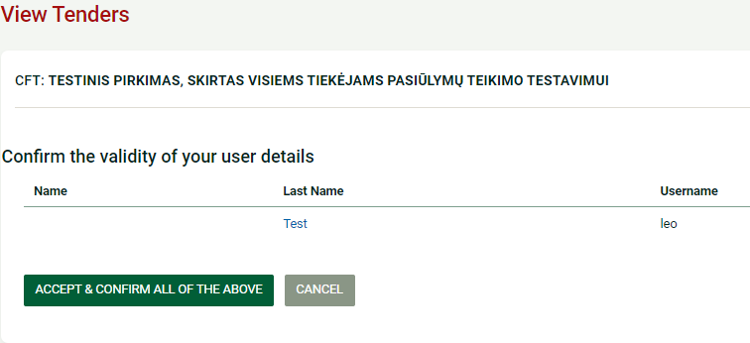
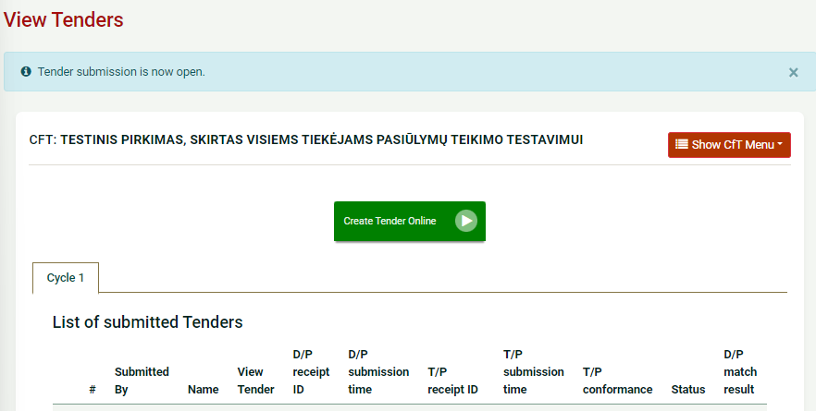
To submit a bid (tender):
2
1
3

Slide 18
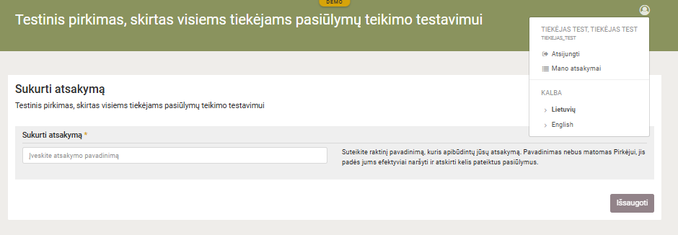
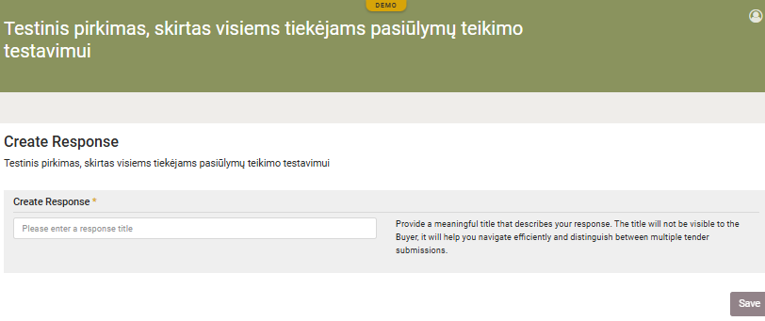
If you see that it is not in English, please set English as the language:
1
2

Slide 19
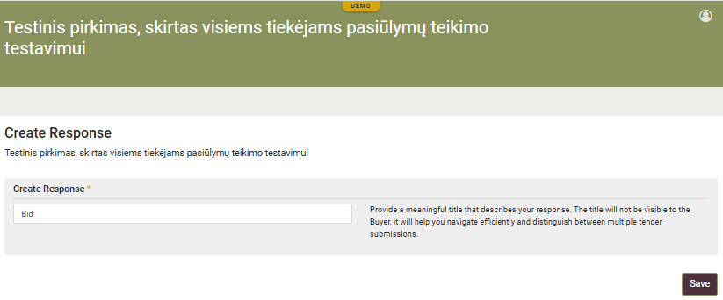
In the field marked with an asterisk, enter “Create Response” and click “Save”. This is the title of your proposal. Only you will be able to see this information
1
2

Slide 20
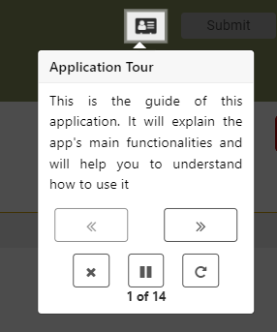
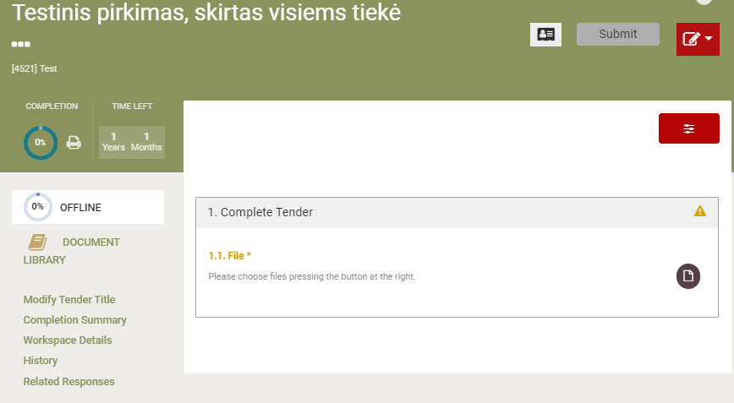
Application Tour.
Clicking through will explain the main features and how to use it

Slide 21
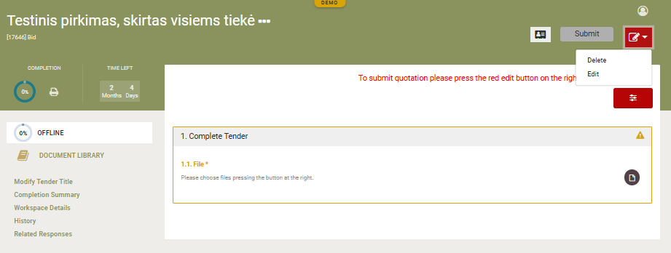
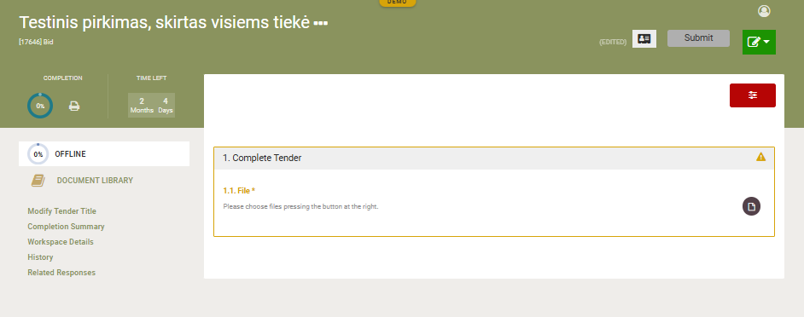

Click the red button (1), click “Edit” (2) and button changes from red to green
1
2

Slide 22
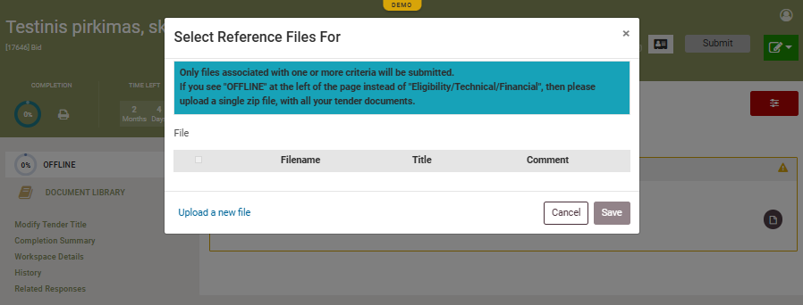
Click on the file icon -> "Upload new file"
2
1

Slide 23
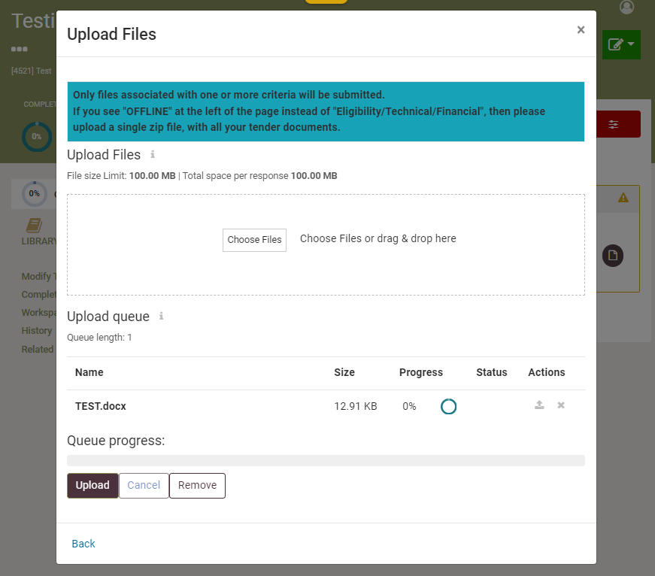
1 - click “Choose files” add the offer document,
2 - the attached document will be visible
3 - press “Upload”, when the button turns gray, press “Back”
4- when the “Upload” button will turn light grey, press the blue letters “Back”
1
2
3
4

Slide 24
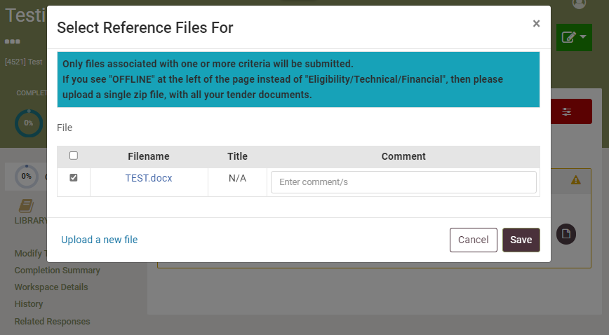
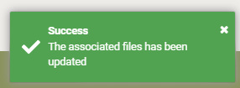
In the “File” column, check the box next to the name of your document, if you want you can write a comment.
IMPORTANT! After ticking, click “Save”, otherwise the document will not be attached
1
2

Slide 25
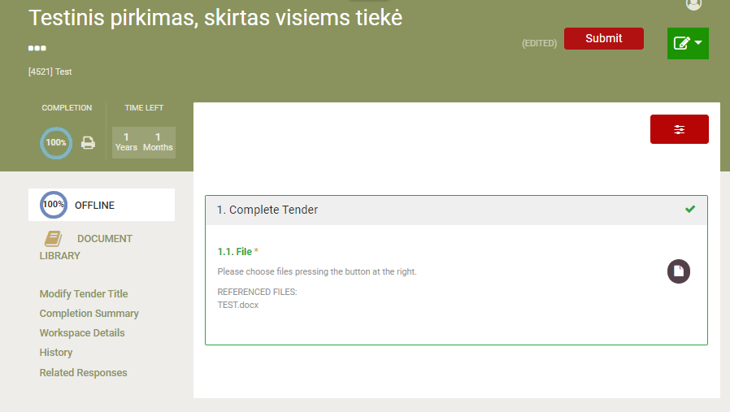
After successfully uploading the bid document (1), the implementation percentages appear.
click “Submit” (2)
2
1

Slide 26
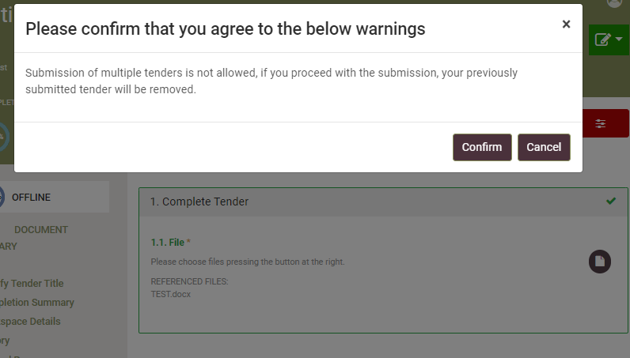
Confirm that you agree to the below warnings

Slide 27
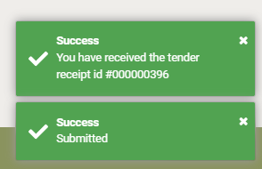
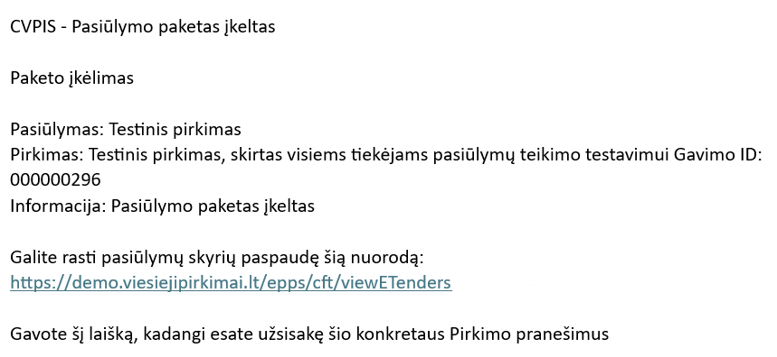
After a successful bid, there will be an entry in the right corner:
You will receive an email about submitting a bid:

Slide 28
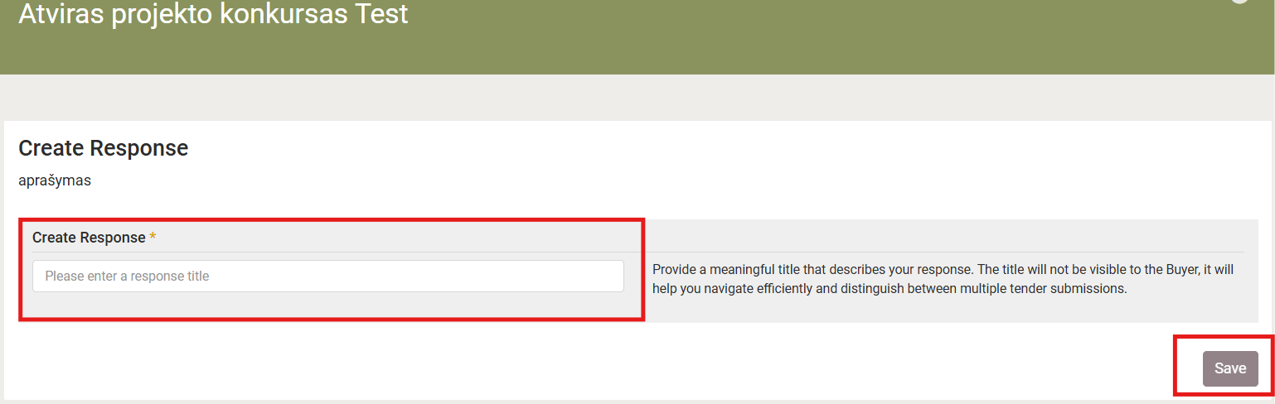

How to submit a bid in Design contest?
In the field marked with an asterisk, enter “Create Response” (1) and click “Save” (2). This is the title of your proposal. Only you will be able to see this information
1

Slide 29
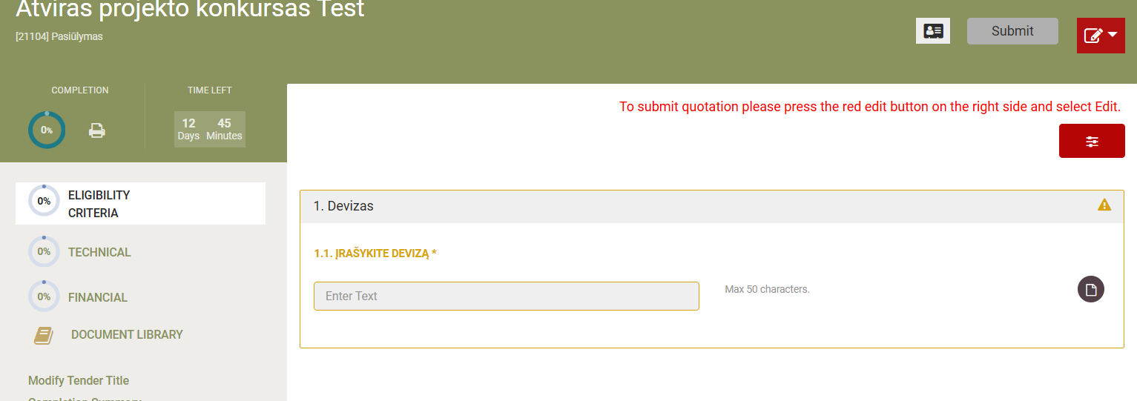
1 envelope consists of the sections “Eligibility criteria” and “Technical” (1).
2 envelope consists of the section “Financial” (1). Please do not disclose the information of the second envelope in the first envelope!
1
2

Slide 30
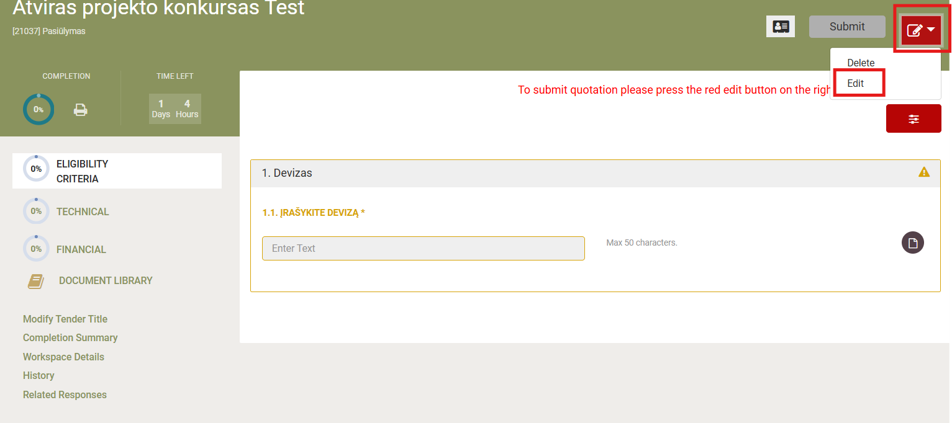
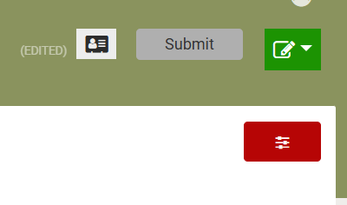
Click the red button (1), select “Edit” (2), and the button will change from red to green (3)
1
2
3

Slide 31
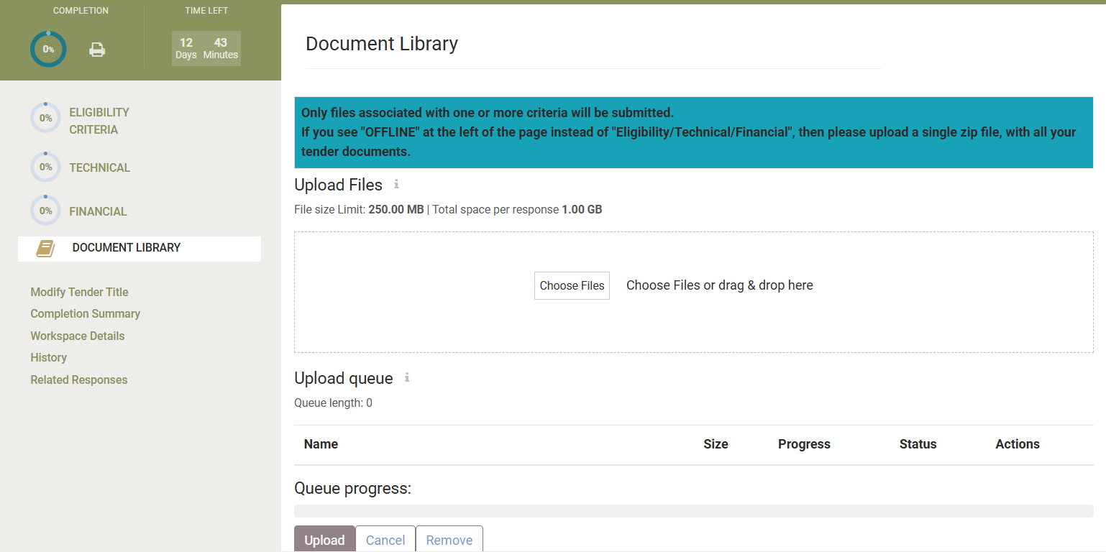
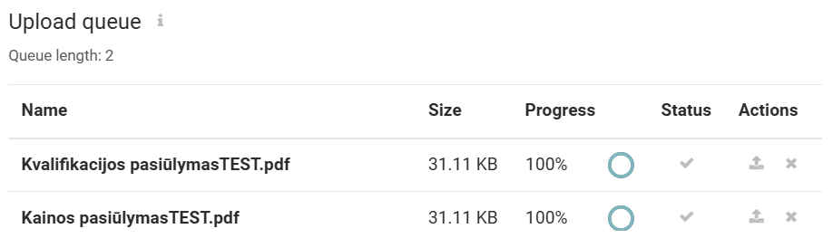
Click on “Document Library” (1), choose files and click on upload (2). The uploaded documents will appear at the bottom of the window (3). The progress must be 100 percent
1
2
3

Slide 32
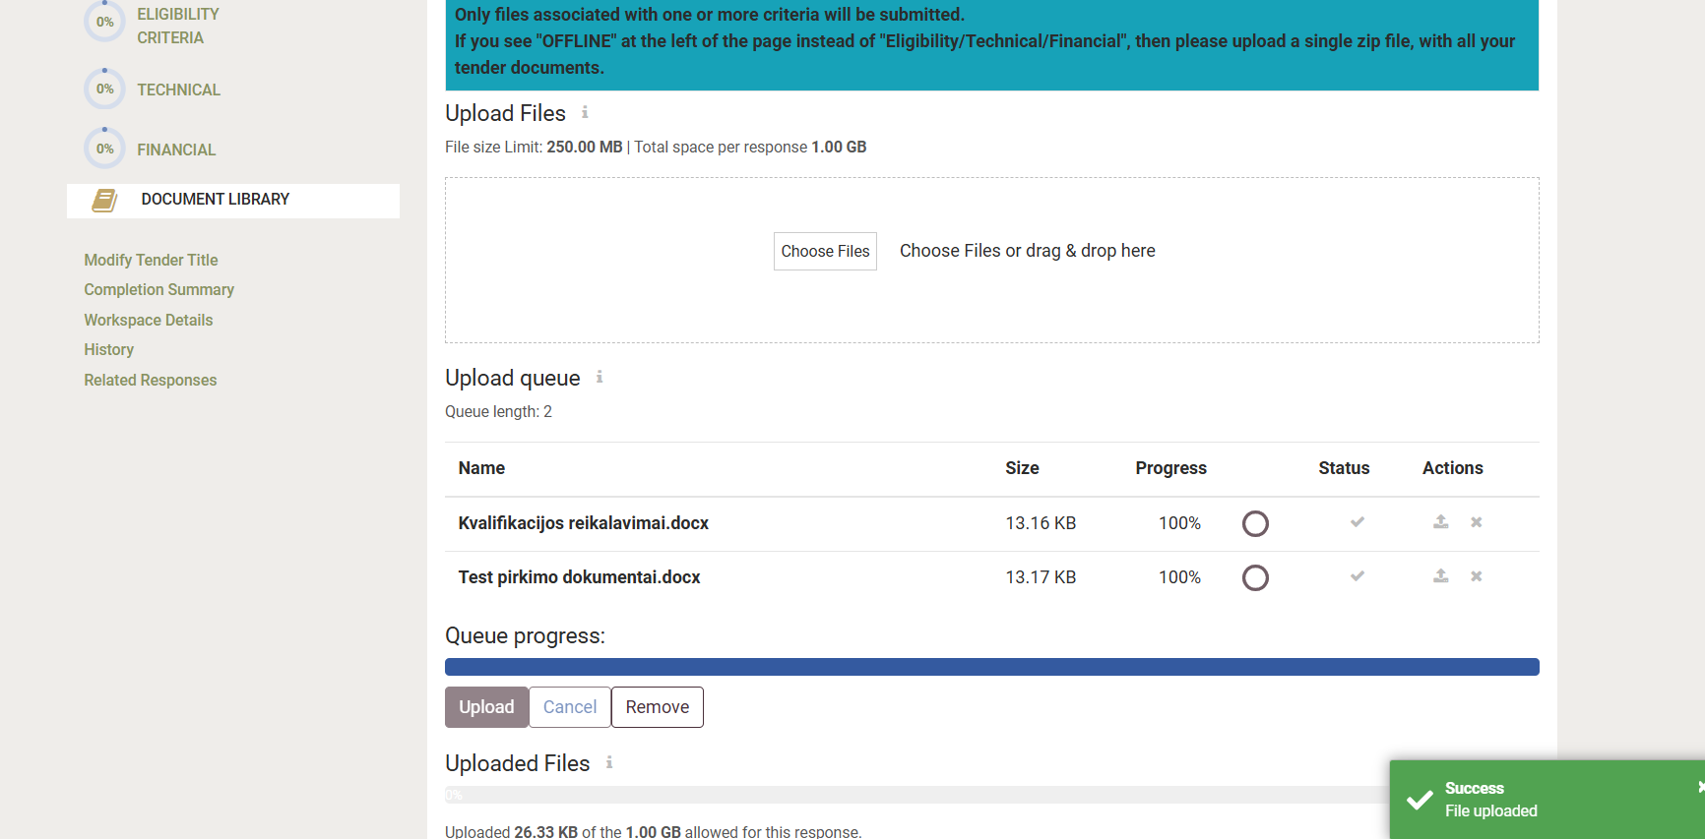
Once you confirm the upload, you will see a message at the bottom of the page confirming that the upload was successful

Slide 33
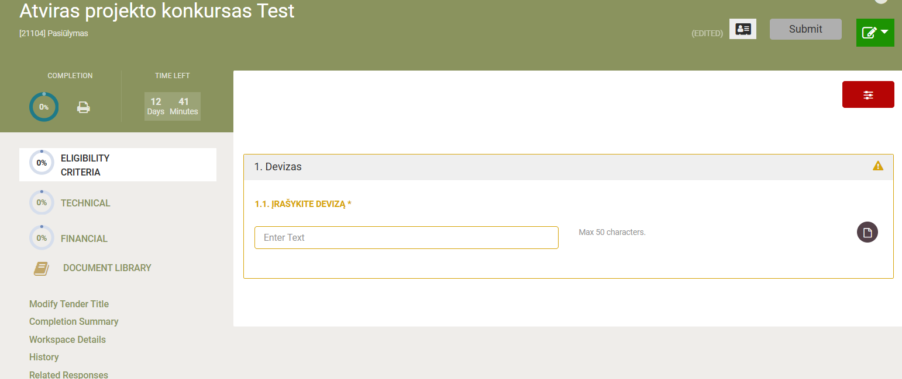
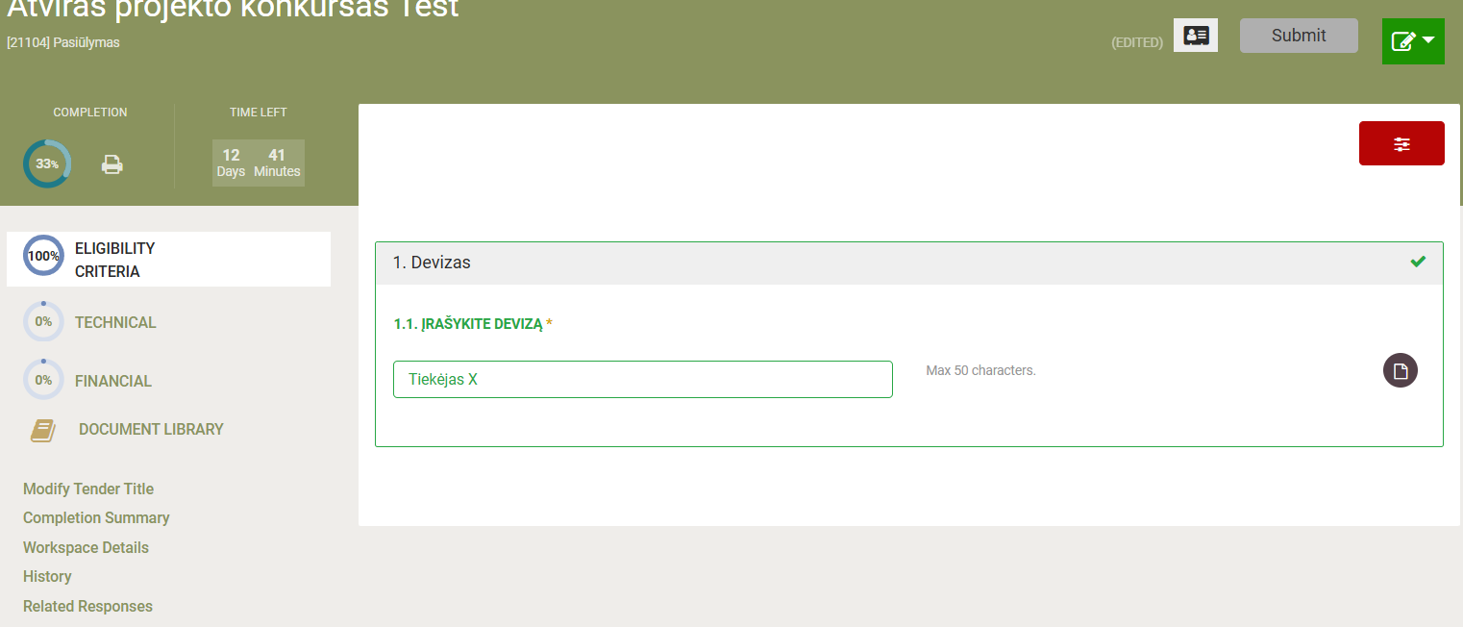
Enter the code name. Once you enter it, the field will turn green

Slide 34
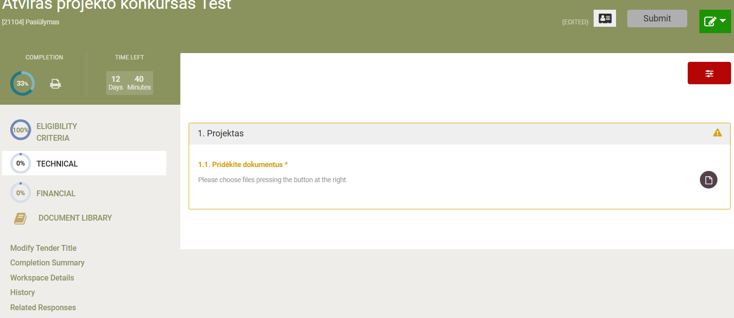
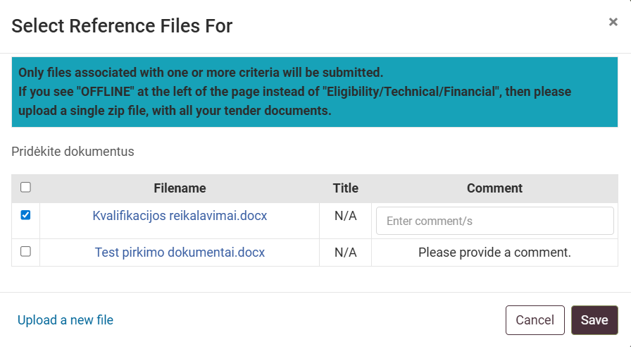
Select the “Technical” section in the first envelope and check the required documents
1
2

Slide 35
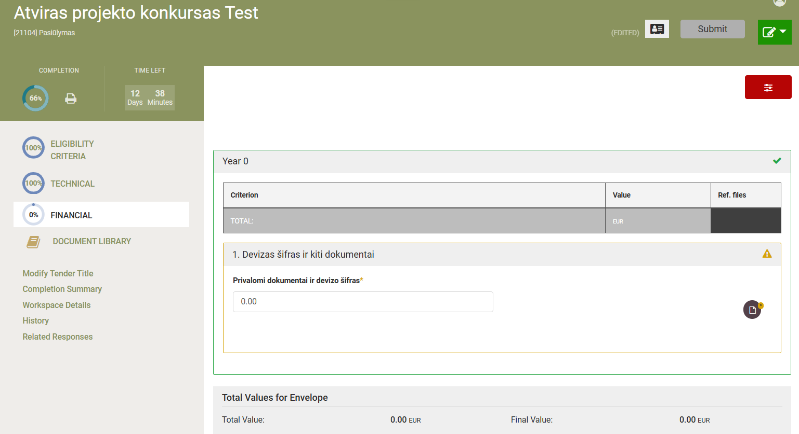
Select the “Financial” section in the second envelope. Enter the price. If the price includes cents, enter them separated by a decimal point
1

Slide 36
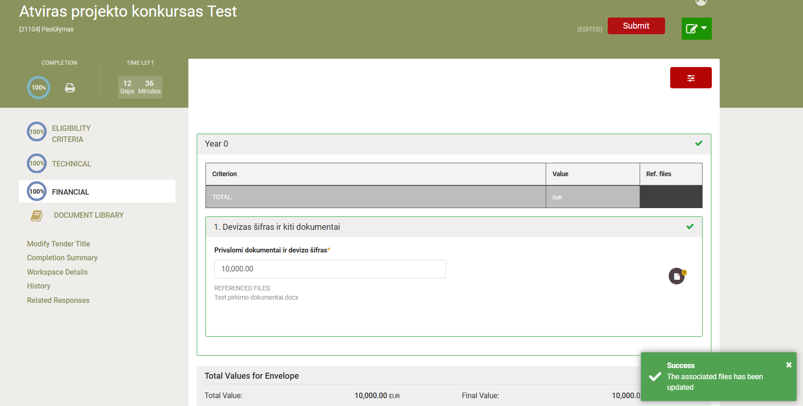
If the file icon is yellow (1), you must also attach the document. Once the upload is successful complete, you will see a message at the bottom (2)
1
2

Slide 37



After uploading all documents, you should see 100% in the “Completion” (1) section. Then click the “Submit” button (2) to submit a bid
2
1
After successfully submitting the bid, you will see the following entry at the bottom of the page:
You will receive an email notification: CPP IS CFT Automated Notification - [CFT: XXXXXX] Tender Package has been uploaded

Slide 38


Information about the submitted proposal and how to amend or withdraw it
Information about submitting an offer by clicking here “My Responses” and “Submitted” status

Slide 39


To find your purchase in the main window of your account. Click:
Purchase Management -> My Purchase List

Slide 40


Review the submitted proposal.
In the selected purchase:
Click Show CFT Meniu (1);
Click ,,Tender“ (2);
Mark the inserted proposal (3);
Click ,,VIEW“ (4);
Click on the file icon (5);
view the submitted proposal documents (6)
1
2
3
4
6
5

Slide 41
How to amend the submitted proposal?
In the selected purchase:
Click Show CFT Meniu (1)
Click ,,Tender“ (2)
Click ,,Create Tender Online“ (3)
Important! The new offer submitted will automatically replace the previous one, and the previously entered offer will no longer be in the system
1
3
2

Slide 42

How to withdraw the submitted proposal?
In the selected purchase:
Click Show CFT Meniu (1);
Click ,,Tender“ (2);
Mark the inserted proposal (3);
Click ,,REMOVE“ (4);
Confirm the removal by clicking "OK" (5).
1
2
3
4
5

Slide 43
Technical support
Email: pagalba@vpt.lt

